Slide 1
UNDERSTANDING HEALTH AND WELLNESS
Chapter One

Slide 2
AN APPLE A DAY

Slide 3
How would you answer these questions?
What is health?
Why would you want to be healthy?
Who is most responsible for your health?

Slide 4
Top Ten Killers of Teens
10-Stroke
9-Chronic Obstructive Disease (Lungs)
8-Pneumonia/Influenza
7-Congenital Abnormalities
6-HIV
5-Heart Disease
4-Cancer
3-Suicide
2-Homicide
1-Accidents

Slide 5
Lesson One Vocab
Health
Wellness
Health Continuum
Chronic disease

Slide 6
Examples of a Healthy Person
Health Triangle
Physical Health (How your body functions)
-get 8-10 hours of sleep each night
-eat nutritious foods, drink 64 oz of h2o a day
-get 30-60 min of activity a day
-avoid alcohol, tobacco, and other drugs
-bathe regularly, brush and floss daily

Slide 7
Mental/Emotional Health (feelings and thoughts, how you cope)
-enjoy challenges
-accept responsibility
-identify and express emotions in appropriate ways
-deal with stress and frustration
-have a positive outlook
-make thoughtful and responsible decisions
Social Health (getting along with others)
-seek and lend support when needed
-communicate well and listen to others
-show respect and care for yourself and others

Slide 8
Seven Dimensions of Wellness “SPECIES” Quiz
1-Social
2-Physical
3-Emotional
4-Career/School
5-Intellectual
6-Environmental
7-Spiritual

Slide 9
WHAT DOES IT MEAN???
350-315: Excellent Choices
314-280: Good Job
279-245: You need to make better choices
244-210: You need to take charge or you are in trouble!

Slide 10
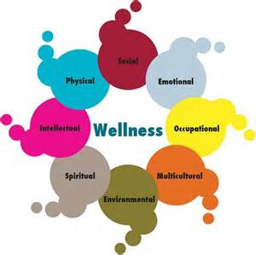
Wellness
When all areas of health are balanced you have a high degree of wellness.
All areas are equal in importance!

Slide 11
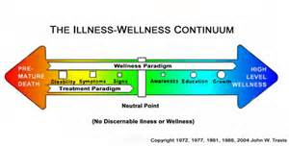
Health Continuum
A lifelong commitment to practicing healthy behaviors will result in your health being at the higher end of the continuum.
Half of all American adults live with an ongoing condition such as heart disease, obesity, and cancer.

Slide 12
Sister Madonna

Slide 13
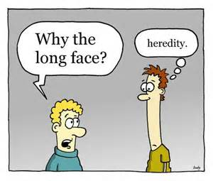
Lesson Two Vocab
Heredity
Environment
Culture

Slide 14
Influences On Your Health
Heredity - diseases and disorders that run in your family ☹
Environment – the sum of your surroundings
Physical-safety in neighborhood and school, air/water, medical care, parks and recreation
Social-all the people around you good or bad influences
Cultural-language, food, beliefs and traditions
Attitude - positive vs negative
Behavior -making good choices
Media and Technology -know what you are looking at
YOU CAN TAKE CONTROL OF YOUR HEALTH BY UNDERSTANDING THE FACTORS THAT INFLUENCE IT!!

Slide 15
Lesson Three Vocab
Risk behavior
Cumulative risks
Prevention
Abstinence
Lifestyle factors

Slide 16
Risk Factors
Risk Factors: anything that increases your risk of disease, injury or other health problems
Risk Factors come in two types:
Controllable-meaning we have some to a lot of control over them
Non-Controllable-we have absolutely no control over these risk factors

Slide 17
Non-Controllable Risk Factors for Disease
Age
Gender
Heredity
Ethnicity

Slide 18
Controllable Risk Factors
Smoking
Diet
Exercise levels
Alcohol/drug use
Sexual behaviors
Risk taking

Slide 19
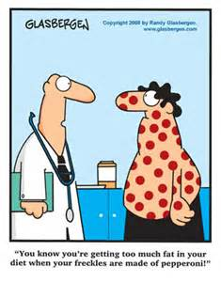
Risky Business
What are some serious illness’s that we can get because of our behaviors?
Heart Disease
Stroke
Diabetes
Obesity
Cancers
STD’s
Abuse issues
Unintentional injuries

Slide 20
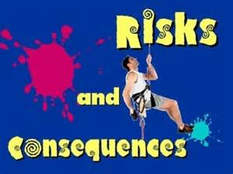
Risks and Consequences
Its important to be able to recognize risky behavior
Consequences can be Short term, Long term, or even Fatal
Cumulative risks increase over time and when combined with several risk factors can be Fatal
By identifying risks you can make responsible decisions

Slide 21
How To Reduce Your Expose to Risks
Prevention: get regular medical/dental checkups, wear a seat belt, check the water before you dive, etc…
Abstinence: avoidance of high risk behaviors like drinking, smoking, using drugs and having sex

Slide 22
Positive Lifestyle Factors For Your Health That Will Reduce Your Risks
Get 8 hrs of sleep a night
Eat breakfast
Eat nutritious foods
Be physically active for 30 to 60 min a day
Maintain a healthy weight
Abstain from smoking, using drugs, alcohol and unprotected sex

Slide 23
Lesson Four Vocab
Health Disparities
Health Literacy
Advocacy (advocate)

Slide 24
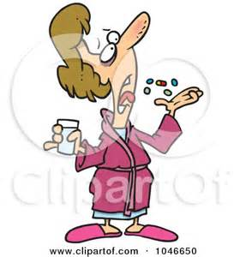
Investing in your health
Each year the average amount spend on an individuals health is?
$500
$1200
$5000
$7600
Answer is $7600 which is 2.3 trillion per year in the US

Slide 25
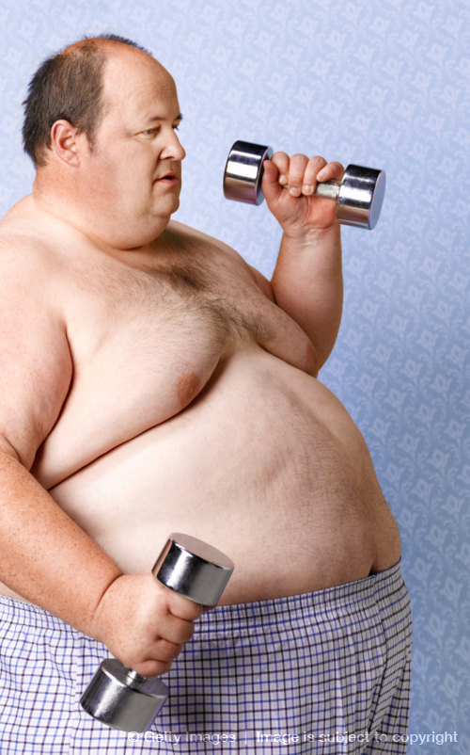
How does personal responsibility for your own health benefit society?
Nations Health Goals

Slide 26
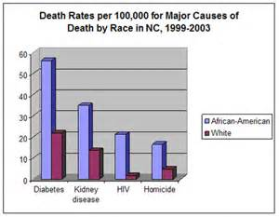
Health Disparities
Gender
Race
Education level
Disability
Location where you live

Slide 27
Being Health Literate
A health literate person knows how to:
-Find and use reliable information
-Is able to decide if the information is correct
-Is able to assess the risks and benefits of treatments
-Can read labels and figure out how much medication to take
-Is able to understand test results
Understanding this information empowers you to live healthfully, and improves the quality of your life.

Slide 28
You are now going to become health literate on a health topic of your choice and complete a Public Service Announcement for a health issue you feel is important to you.

Slide 29
PSA Project
PSA PROJECT
Create either a: Poster, Pamphlet, or
youtube video
It should contain: What it is, how it affects your health, how to not get it, how to manage or cure it, who is most likely to get it, statistics, pictures, sites where you can get more information on it, etc…
Due date is: One week from today.
Send youtube video to: toninatl@milwaukee.k12.wi.us

