Slide 1
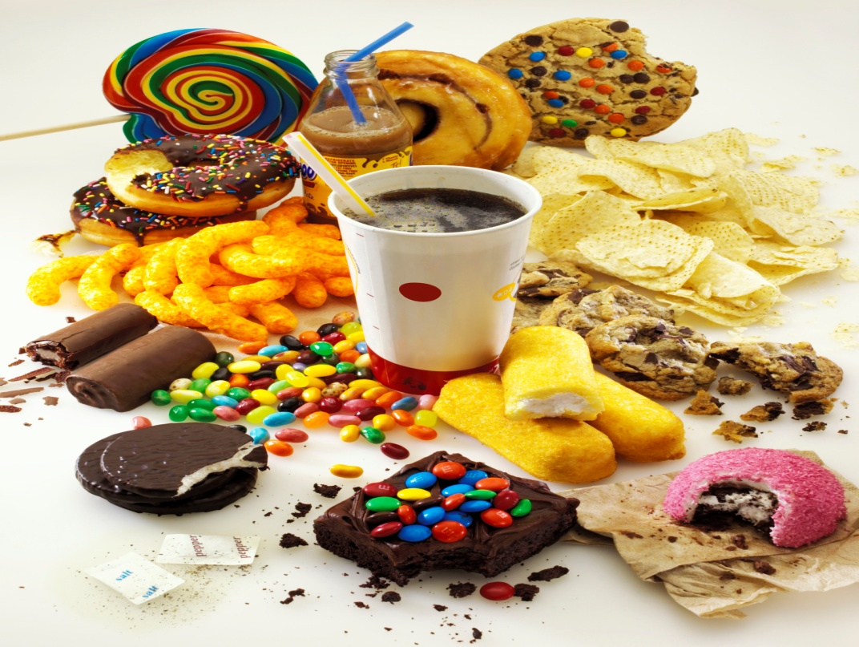
Nutrition For Health
Chapter 10

Slide 2
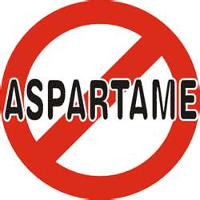
Vocabulary Words
Nutrition Osteoporosis
Nutrients Minerals
Calories Vitamins
Appetite
Carbohydrate
Proteins
Cholesterol

Slide 3
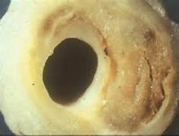
The Importance of Nutrition
Teens need good nutrition for healthy growth and development
Good nutrition lowers the risk of:
Heart disease Diabetes
stroke obesity
certain cancers
osteoporosis

Slide 4
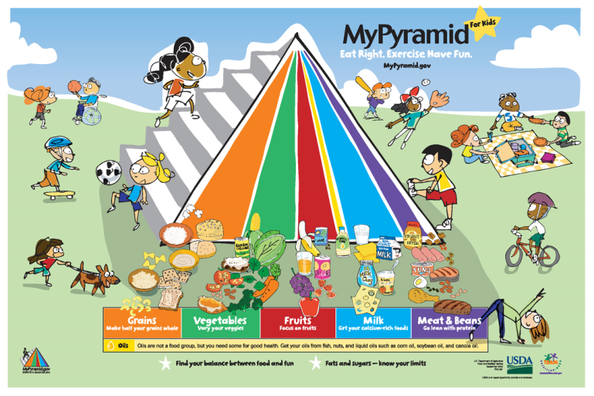
Nutrition Assessment
3-ALWAYS 2-USUALLY 1-NEVER
I eat one raw fruit or vegetable every day
I drink fewer than 5 soft drinks a week
I avoid adding salt to my food
I eat food high in fiber daily
I read and understand food labels

Slide 5
6. I eat foods low in fat
7. I stay within 10 pounds of my ideal weight
8. I avoid eating sugared cereals
9. I avoid eating snacks high in salt or sugar
10. I eat a nutritious breakfast every day
11. I avoid eating fried foods
12. I eat foods high in nutrition and low in fat and calories
13. I am aware of high calorie, low nutrient foods
14. I drink plenty of water daily
15. I choose to eat nutritious snacks
16. I avoid “junk foods”
17. I eat three nutritious meals a day

Slide 6
18. I am aware of the calories I eat
I avoid foods that contain large amounts of additives
I am aware of the dangers of dieting for young people
I eat to live instead of live to eat
I know how to calculate the % of fat in my foods
I choose to eat most of my foods from the left side of the pyramid
I avoid products that contain caffeine
I understand the risks that I take if I choose to eat unhealthy foods

Slide 7
Evaluation
51-45 OOPS! Your Dead! Well, not really but you may be putting yourself at risk.
59-52 NOT BAD! Some better decisions will improve your wellness.
66-60 VERY GOOD!
75-67 EXCELLENT! Keep up the good work!

Slide 8
Why do we eat?
When you are hungry you may feel tired or lightheaded so you need to eat to feel better. This is a Physiological need.
Appetite is a psychological need. Eat because we want to.
Emotions can make us eat
What we eat is largely determined by
a-family and culture c-time and money
b-friends d-advertising

Slide 9
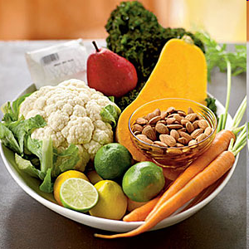
What is a nutrient?
A substance that provides
nourishment That is essential
for the growth and maintenance
of life.

Slide 10
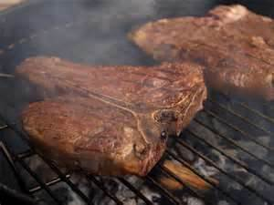
Six Nutrients we need
Carbohydrates
Proteins
Fats
Vitamins
Minerals
Water

Slide 11
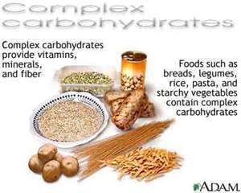
Carbs
Used as a source of energy
45 to 65% of your daily calories
Found in: grains/products, fruits, vegetables
Three types:
Simple-sugars found in fruits, dairy, sugar, candy, honey, and soda
Complex-starches in grains, grain products, (breads/pasta) beans, and root vegetables
Fiber-tough complex carb that your body cannot digest

Slide 12
Hidden Sugar
Sugar is a carb
Sugar provides us with “empty calories”
If you don’t burn off the carbs they are stored as fat on your body

Slide 13
Sugar and your brain

Slide 14
What kind of breakfast do you eat?
Are you hungry during 1st period?

Slide 15
Simple carbs

Slide 16
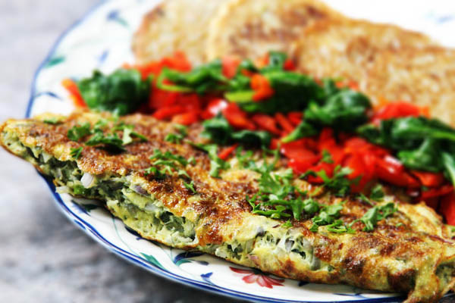
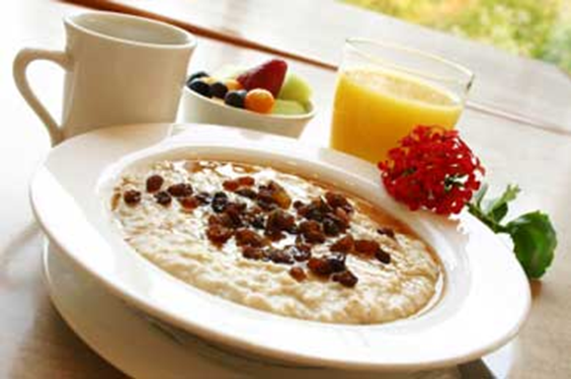
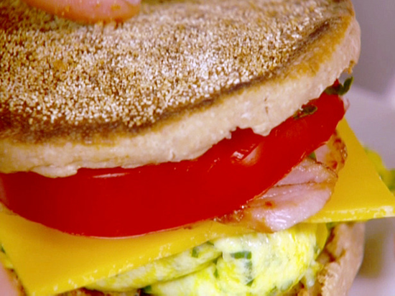
Complex carbs

Slide 17
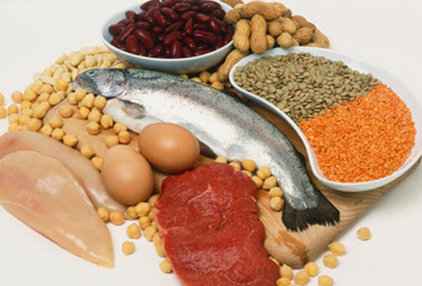
Protein
Amino Acids are the building blocks of protein. They Make up the muscles, tendons, organs, nails, and hair.
Used for growth and repair-there are 22 amino acids
Found in meat, nuts, dairy, legumes
A- Essential amino acids are the 9 amino acids the body CAN’T produce.
B- Nonessential body CAN produce.
C- Complete protein- contain all essential AA. Animal products
D- Incomplete protein-contains 8 or less of the essential AA. Plant products
10-15 % of diet

Slide 18
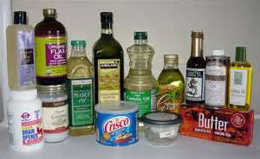
Fats
You need some fat to function properly
Fats are used for energy, but only after you have used all your carb energy
Types of Fats:
Unsaturated- vegetable oils, nuts, seeds. May help to lower HD in moderate amounts
Saturated- Meat, dairy, palm, coconut. Too much of these increases risk of HD
Trans fats- Margarine, snack foods packaged baked goods. Increases cholesterol which increases chance of HD. This is the worst form of fat!!!

Slide 19
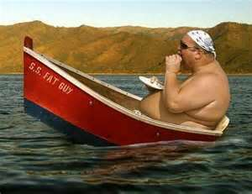
Fat……..
Calories from fat that your body doesn’t use are stored as fat
Too much fat = disease
Too much saturated fat = high cholesterol levels
Less than 25-35 % of
your calories
Best oil to cook with is
olive

Slide 20
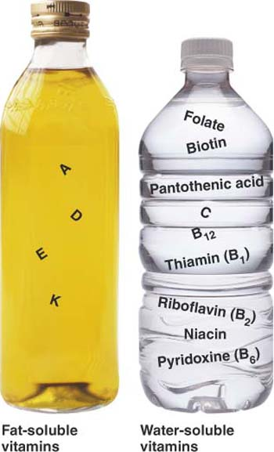
Vitamins
Fat Soluble (absorbed & stored)
K,A,D,E
Water Soluble (Lose through urine)
B, C

Slide 21
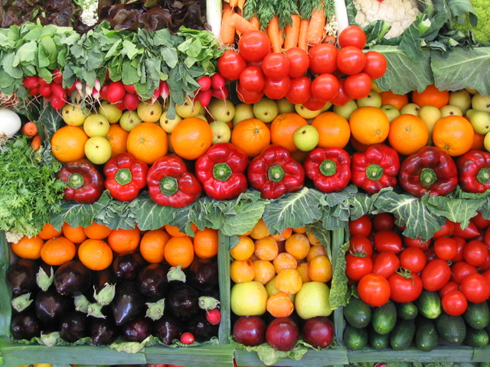
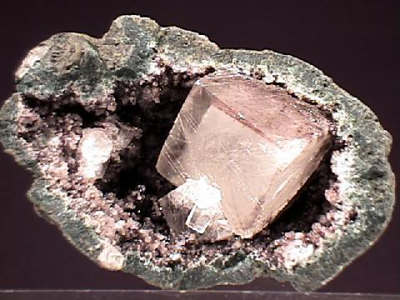
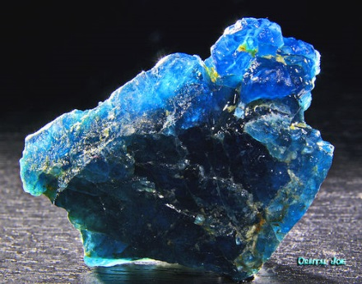
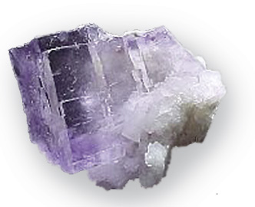
Vitamin and Mineral Functions
Antioxidant
Water Balance
Bone Health
Blood Health

Slide 22
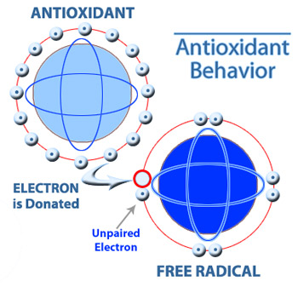
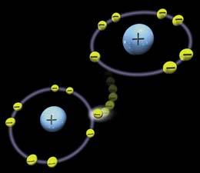
Antioxidants
Stop oxidation or free radicals
Anti aging, anti-cancer, cell protection
Notes:
If the outermost shell of electrons is not full, the atom will try to fill the void, or empty out its electrons in that shell. It can fill the void by sharing electrons with another cell. The unstable atoms "steal" electrons from stable molecules, causing the molecule itself to become a free radical, leading to a chain reaction that can disrupt the life of a living cell. Why do free radicals happen?
When the body metabolizes food, cells break down. Usually the breakdown results in stable atoms, but it's not always the case. Sometimes the body's immune system will create free radicals to neutralize viruses and bacteria. But this is natural and this level of free radical activity can be handled by our bodies.
Free radical damage was not a problem in early human history. But since the Industrial Revolution, we've been adding more and more pollution and other toxic particles into our environment. Toxic metals in your body can increase the free radical chain reaction by thousands to millions of times its normal rate.
Our environment is the cause of chemical destabilization of the molecules in the human body. Things like radiation, pollution, herbicides and pesticides, and smoking cause the free radical creation process to speed up in the body, thus causing damage to the body's cells over time. Free radical damage within cells has been linked to many disorders that include cancer, arthritis, Alzheimer's, and diabetes.
Free radicals cause damage to our cell membranes, causing these cells to harden up or breakdown. If the cell wall (membrane) is hardened, it becomes nearly impossible for that cell to get nutrients or perform its natural cellular functions. Free radicals can also cause damage to our RNA and DNA. How Can I fight Free Radicals?
Antioxidants are molecules that are capable of slowing or preventing free radical damage to healthy molecules. Vitamin A, vitamin C, and vitamin E and so on can prevent free radicals from oxidizing your healthy molecules. There are numerous studies that show that antioxidants can slow the aging process and prevent diseases. Be Aware of your environment
Keeping an eye on what you eat is the easiest way to reduce free radical damage. Are you eating meats that come from a toxic environment, or have a diet full of highly synthetic and processed foods? Is your diet lacking in antioxidant rich foods like fruits and vegetables? By sticking to an all-natural (or close enough) diet, you not only get your fill of antioxidant foods, but reduce the amount of processed and unhealthy foods that can cause free radical damage. Antioxidant Supplements
Green tea has been incredibly effective for fighting free radical damage. Whether you take it as a drink, or in the form of a green tea weight loss product, green tea is proven to be an antioxidant rich source. Of course, remember what supplements are! They "supplement" a healthy diet so don't expect them to work as effectively as they can if your diet is poor. Calorie Restriction
Another part of waste is passed off through the skin in the form of watery vapor as perspiration, or sweat. But part of the waste can be gotten rid of only by burning, and what we call burning is another name for combining with oxygen, or to use one word—oxidation;
Moreover, this is precisely the purpose of the carrying of oxygen by the little red blood cells from the lungs to the deeper parts of the body—to burn up, or oxidize, these waste materials which would otherwise poison our cells. When they are burnt, or oxidized, they become almost harmless.
While oxygen supports our life, and "oxidizes" or "burns" food to create energy and heat for our bodies, certain types of altered oxygen molecules called "Free Radicals" which are ever-present in our bodies, will damage our own cells and even our DNA, causing degeneration and diseases such as cancer.
A "radical" is an atom with an unbalanced electrical charge, and it will seek to steal electrons from other atoms - such as the atoms of our body cells!

Slide 23
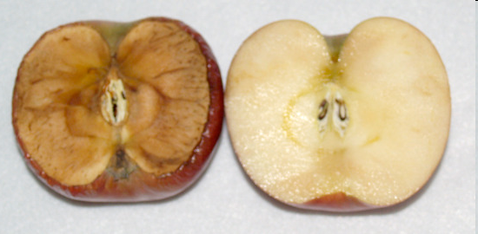
Oxidation

Slide 24
Antioxidants
Vitamins A,C, E

Slide 25
Foods Rich in Antioxidants

Slide 26
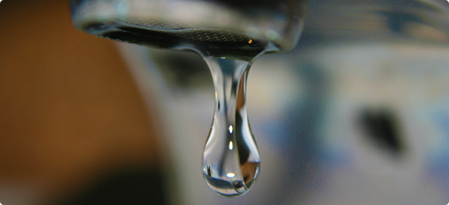
Water
Is essential for most body functions, without it we would die, 60% of our body weight is water
We lose 8-12 cups a day
Girls should have 9 cups a day and boys 13 cups
If you feel thirsty you are already dehydrated
For exercise, drink ½ cup every 10-15 minutes.
Sports drinks contain too much sugar & salt.
Limit consumption of coffee, tea and soft drinks that contain caffeine it is a diuretic

Slide 27
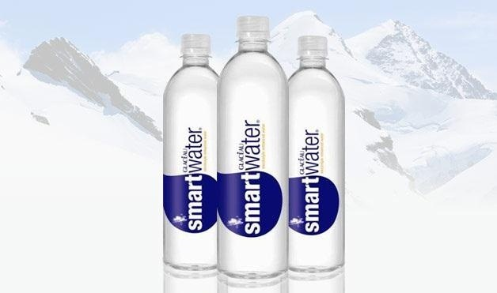
Water Balance (electrolytes)
Helps with hydration
Regulates body temperature
Lubricates joints
Maintains Blood pH
Lean muscle contains 75 % water
Not enough water cause constipation
Too much water can cause diarrhea

Slide 28
How can you tell if you’re dehydrated?

Slide 29
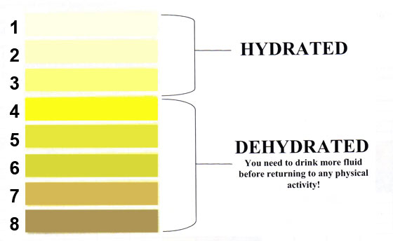
Are you getting enough water?

Slide 30
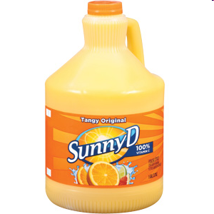
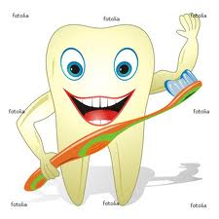
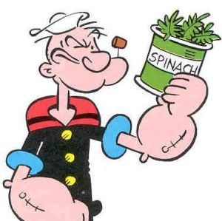
Bone Health needs…
Calcium Vitamin D
Fluoride Vitamin K

Slide 31
Blood Health is important for..
Transportation oxygen
Transportation nutrients
Get rid of waste products
Temperature regulation
Clot wounds

Slide 32
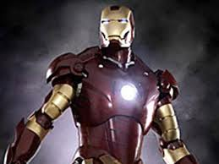
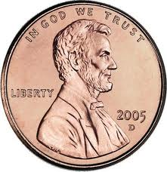
Healthy blood needs….
Iron
Copper
B6, B9, B12
War causes blood

Slide 33
List-Group-Label
Iron
Vitamin A
Potassium
Sugar
Beans
Butter
Nuts
Sugar
Sodium
Essential & Nonessential
Calcium
Vitamin C
Soda
Vitamin K
Copper
Simplex
Fiber
Oil
Amino Acids
Pasta
Phosphate
Fluoride
Fish
Complex
Eggs
Chloride
Vitamin E
Bread
B Vitamins

Slide 34
Answers
Proteins
Minerals
Carbohydrates
Beans
Essential &
Nonessential
Amino Acid
Eggs
Fish
Fats
Calcium
Phosphate
Iron
Copper
Potassium
Fluoride
Sodium
Chloride
Sugar
Soda
Simple
Complex
Fiber
Pasta
Bread
Butter
Oil
Fish
Eggs
Vitamins
Vit A,C,E, K
B Complex

Slide 35
Vocab for lessons 3 and 4
Nutrient Dense
Food additives
Food bourne illness
Pasteurization
Cross-contamination
Food allergy
Food intolerance

Slide 36
Making Smart Choices
USDA and MyPyramid are two things that you can get information from to make better decisions
Recommendations are to eat:
Lots of fruits and veggies
Get calcium from low-fat and fat-free dairy
Make half your grains whole
Choose lean cuts of meat
Limit high fat foods, salt and sugar

Slide 37
Nutrient Density
The more nutrient dense a food is the more nutrients it packs into a given number of calories
Example: three cups of carrots and ½ of a snack bag of chips have the same number of calories but the carrot is more nutrient dense
If your overall diet is nutrient dense you can include an occasional treat

Slide 38
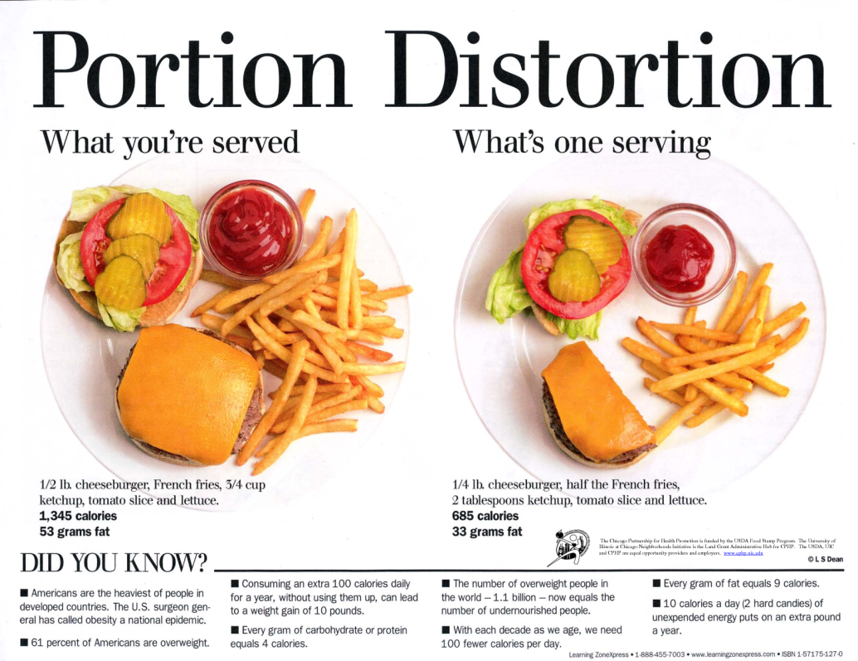
Eating Right When Eating Out
Watch portion sizes
Pay attention to how its made
Add fresh fruit and veggies
Go easy on toppings
Don’t drink your calories

Slide 39
Label Basics
Name
Amount in the package
Name and address
of company that makes it
Ingredients
Appear in descending order by weight
Nutrition Facts
Calories, amounts of protein, carbs, fats, vitamins,
minerals, serving size, rda’s etc…

Slide 40
Label claims
FREE- contains little to no of a given component
LOW- you can eat regularly without exceeding your daily limits. 3gr or less of fat
LIGHT- 1/3 fewer calories, ½ fat or sodium of the original
REDUCED- 25% fewer calories or 25% less of a nutrient
HIGH- 20% of the daily value
GOOD SOURCE OF- 10-19% of the daily value
HEALTHY- low in fat and sat fat, limited amounts of cholesterol and sodium

Slide 41
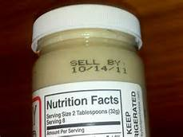
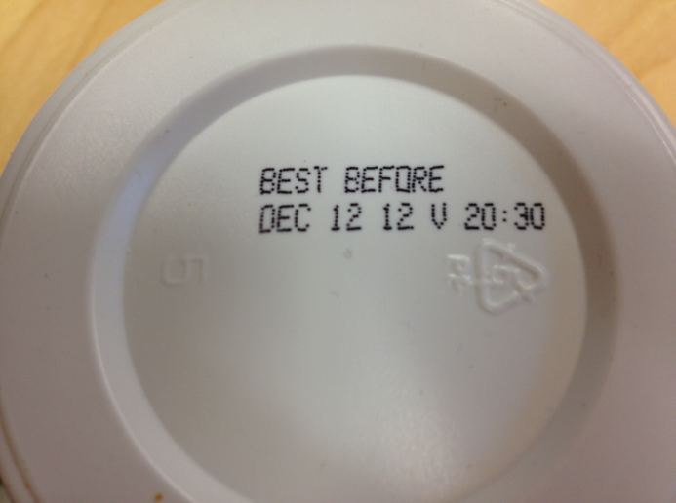
Labels….
Sell by: last date a store should sell it
Use by or expiration date: last date guaranteed
Freshness date: short shelf life
Pack date: date it was packaged

Slide 42
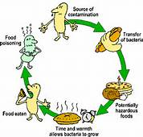
Keeping Food Safe
Make sure milk/juice is pasteurized
Clean all utensils and cutting surfaces
Separate foods most likely to carry pathogens like meat, eggs, seafood
Cook to a high enough temp
Chill in freezer, fridge or a cooler

Slide 43
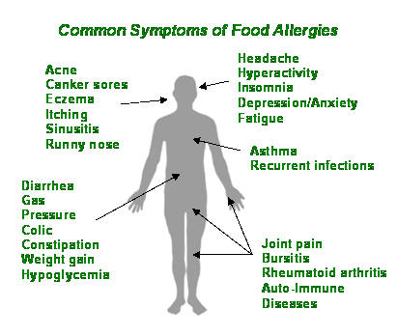
Food Sensitivities
Allergens are found in milk, eggs,
peanuts, tree nuts, soybeans, wheat,
fish and shellfish
Allergens involve the immune system Symptoms range from rashes to death
Intolerances are more common and and don’t involve the immune system.
Common examples: dairy or gluten

Slide 44
Rate That Snack
Rank in order from highest to lowest:
Activity One-calories
Activity Two-fat
Activity Three-sugar
Activity Four-best food

