Slide 1
Taking Charge of Your Health Important skills
Chapter 2, 6

Slide 2
Vocab Lesson One and Two
Health Skills
Interpersonal Communication
Refusal Skills
Conflict Resolution
Values
Decision-making skills
Goals
Action Plan

Slide 3
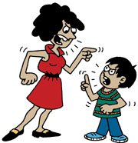
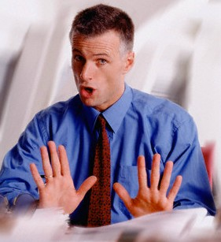
TEN IMPORTANT SKILLS FOR GOOD HEALTH and
THEIR BENEFITS

Slide 4
1-Good Communication Skills
Interpersonal Communication-exchange of thoughts, feelings and beliefs between two or more people. Benefit is…….
Four Types of Communication styles:
Aggressive- overly forceful, pushy or hostile.
Passive-unwilling or unable to express your thoughts and feelings in a direct or firm manner.
Assertive-being able to express your views clearly and respectfully.
Passive-Aggressive-indirect expression of hostility
To communicate effectively you need to be able to speak, listen and use non-verbal communication.

Slide 5
Health Skills-tools to help with health responsibility
“I Messages”: way to express your feelings that focuses on your emotions/feelings rather than placing blame on others. Page 154
“You Message”
“I Message”
“Why can’t you ever show up on time.”
“You never listen to anything I say.”
“You always ignore me when your other friends are around.”
“I said I would take out the trash, and I will! You don’t have to nag me about it every five minutes.”
“I really don’t like to be left waiting, it makes me feel like you don’t feel like I am important.”
“I feel like my suggestions aren’t being taken seriously.”
“I feel hurt when I’m left out of a conversation.”
“I am stressed because I have a big project due tomorrow. I’ll take out the trash as soon as I am finished.”

Slide 6
How to communicate more effectively
Listening Skills
Be an ACTIVE
Non Verbal Communication
BODY LANGUAGE
Don’t interrupt
Show interest
Restate
Ask questions
Show empathy
Not what but how you say something
Gestures
Facial expressions
Posture
Behavior

Slide 7
2-Refusal Skills
How can you resist peer pressure???
S.T.O.P. Strategy
S ay no in a firm voice.
T ell Why not.
O ffer other ideas.
P romptly leave.

Slide 8
Other ideas?
Blame someone else
Give a reason
Ignore the request
Leave
Say “no thanks”
Say no and mean it
Make a joke
Make an excuse
Suggest something else

Slide 9
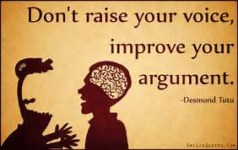
3. Conflict Resolution
Being able to resolve conflict in appropriate ways.

Slide 10
4. Accessing Information
Being able to find good products, services and information regarding your health.

Slide 11
5. Analyzing Influences
Understanding what influences your health decisions (values, beliefs, perceptions, curiosity, family/culture, media, friends/peers, school/community)

Slide 12
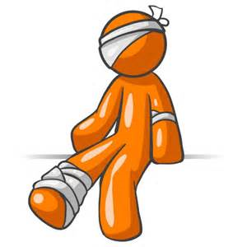
6. Practicing Healthful Behaviors
Acting to reduce risks of illness/injury

Slide 13
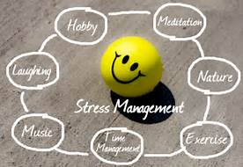
7. Stress Management
Being able to find healthy ways to cope with or reduce stress in your life

Slide 14
8. Advocacy
Working to improve your own health, the health of your family and of your community (share the information that you know)

Slide 15
Advocate for health!

Slide 16
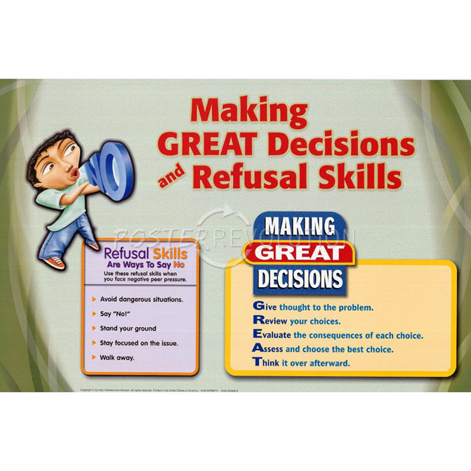
9. Make Good Decisions
Is my decision:
H ealthful-does this choice present any health risks?
E thical-does this choice reflect what you value?
L egal-does this option violate any laws?
P arents-would they approve?

Slide 17
When making a decision you should use PROPS
Pause: Breath deep and tell yourself you can figure it out!
Reflect: on the situation. What is the decision that needs to be made?
Options: It may seem you have not choices but in fact you do. Think about the likely benefits and risks of each option and the possible results.
Prioritize: your options on the basis of your values. What’s at stake in both the short and long term
Select: the most effective option; make your decision and review.
Make sure after you reflect on the outcome!

Slide 18
Why do teens make BAD decisions more than adults???

Slide 19
10. Goal Setting/Action Plan
Being able to set goals and develop an Action Plan to achieve them
Short term: short period of time like two weeks to keep you on track to achieve your long term goal
Long term: more time more planning, the big thing that you want to achieve

Slide 20
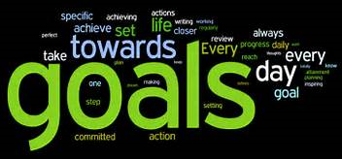
Goals are more attainable if we use the SMART system
SMART GOALS
S- specific
M-measurable
A-attainable
R-realistic
T-time bound

Slide 21
Action Plan: helps you to reach the goal
a. Write them down (accountablility)
b. List the steps (short term goals)
c. Identify who can help
d. Set a reasonable time to achieve
e. Evaluate your progress by using using the short term goals as markers
f. Reward yourself

Slide 22
Vocab Lesson Three and Four
Health Consumer
Warranty
Consumer Advocate
Malpractice
Health Fraud

Slide 23
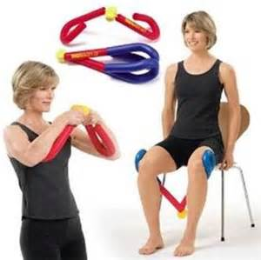
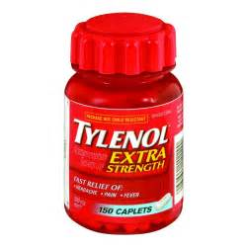
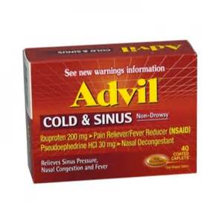
Being a Health Consumer
What are some types of products or services people use to maintain their health?
What are some good strategies for being a smart shopper?

Slide 24
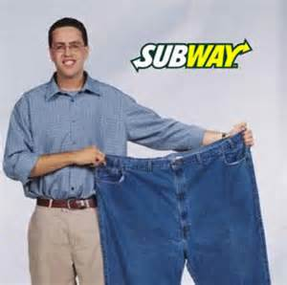
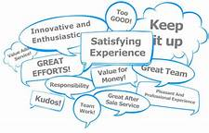
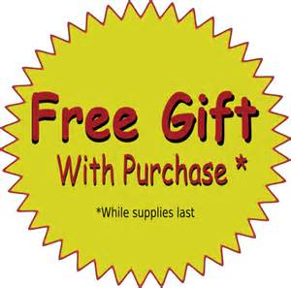
Understanding Advertising
Hidden Messages
Bandwagon
Rich and Famous
Free Gifts
Great Outdoors
Good Times
Testimonial

Slide 25
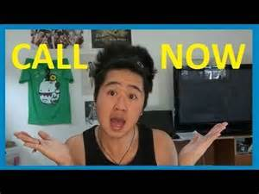
Warning Signs of Fraud
Secret formula
Miracle cure
Overnight results
All natural
Hurry, this offer expires soon

Slide 26
What does Fraud look like??

Slide 27
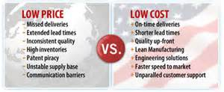
How you should buy
Comparison Shop
-cost and quality
-features
-warranty
-safety
-recommendations

Slide 28
Where do I go if I have problems?
These organizations will help
BBB
Consumer advocates
Gov agencies like the FDA and the Consumer Product Safety Commission
AMA for health care issues

Slide 29
END OF UNIT ONE
TEST NEXT CLASS ON CHAPT. 1,2, 6 (COMMUNICATION)
EVIDENCE FOR THIS UNIT THAT WAS/IS DUE:
Media Message
“I” Message/Smart Goal
Reviews for Chapters 1 and 2
PSA Project
PRACTICE FOR THIS UNIT
Unit One Practice Packet

