Slide 1
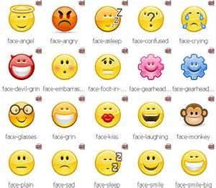
Achieving Mental and Emotional Health

Slide 2
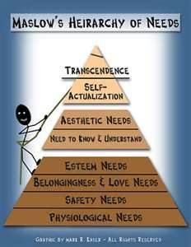
Vocab for Chapter 3
Mental/Emotional Health
Resilient
Hierarchy of Needs
Self-actualization
Character
Integrity
Hormones
Defense Mechanism

Slide 3
“The only difference between a good day and a bad day is…………..
………YOUR ATTITUDE!”

Slide 4
MENTAL WELLNESS The Choice is Yours
UNHEALTHY
Doesn’t share feelings
Emotions control behavior
Pessimistic
Ignores/Denies the problem
Holds things inside
Cannot accept change
Gets emotional needs met in unhealthy ways
Lets stress control their life
“You” messages
Aggressive or passive
Depressed
Avoids/runs from conflict
Doesn’t listen to different points of view
Needs to “run” the group
HEALTHY
Shares feelings
Expresses emotions in healthy ways
Optimistic
Problem Solves
Seeks help when needed
Copes with change
Gets emotional needs met in healthy ways
Stress management
“I” messages
Assertive
Positive attitude
Resolves conflict through negotiation skills
Active listener
Can be part of a team/group

Slide 5
Good Mental Health Begins with….
Sense of belonging
Sense of purpose
Positive outlook
Self-sufficiency
Healthy Self-esteem

Slide 6
Self-Esteem
What is it???
How much you value, respect, and feel confident about yourself.
Why is it important???
In what ways does good or bad self-esteem influence our lives??
Things you can do to improve it:
choose your friends wisely deal with problems
focus on the positive list your positives
use mistakes as learning tools forgive yourself
try new things reward yourself
volunteer exercise
keep a positive attitude

Slide 7
Self-Esteem Check List
I feel good about who I am and I like myself in general
I enjoy interacting with others
I enjoy independent pursuits
I can voice discontent without belittling others or myself
I accept that I have strengths and weaknesses
I like to try new things
I don’t put myself down, saying things like “I’m an idiot”

Slide 8
I don’t hang with people who put me down
I don’t get frustrated and quit too easily
I am proud of my abilities and accomplishments, but I do not show off
I accept that there are some things that I am good at and some things that I could be better at
I take responsibility for both the good and the bad things that I do or say
It is not the end of the world if I lose
I accept that it is OK not to be perfect

Slide 9
Before I do something, I usually think, “I can do it”
I accept things that I cannot change about myself like how tall I am
I have set goals for myself, and I have a plan for how to accomplish them
I feel I have ideas and opinions to contribute and I am not afraid to voice them
I feel comfortable making eye contact with others
I forgive myself for my mistakes
TEN OR MORE = GOOD SELF-ESTEEM

Slide 10
Band aid Activity
How often do you hear or see yourself or others exhibit a behavior that might be considered negative or a “put down”
Does media typically demonstrate negative or positive information?
Assignment: Listen to your peers “talk”. Record how often you heard or see negative vs positive words or behaviors. We will discuss this next class. Who ever reminds me first to do this next class gets a health buck.

Slide 11
Resiliency
Ability to bounce back from set backs
People who are Resilient:
-believe in themselves
-focus on the positive
-take charge of their own behavior and decisions
-set goals and have a plan for reaching them
NOT EVERYONE IS NATURALLY RESILIENT, BUT IT CAN BE LEARNED AND STRENGTHENED

Slide 12
Developing Self-Awareness
Maslow’s Hierarchy of needs: pyramid upon which meeting our needs leads to personal development
Self-actualization: strive to be the best you can be

Slide 13
Teens Hierarchy of Needs
Physiological Needs (survival :food, water, shelter,)
Safety Needs (security: stability, freedom from fear)
Social Needs (belonging and acceptance: family, friends, love relationships, community connections,
Esteem Needs (achievement and recognition: respect, support, confidence, self-esteem)
Self-actualization (reaching one’s full potential: self-fulfillment through individual talent and creativity, setting goals and having discipline to reach them)

Slide 14
Character Plays a Significant Role in your Actions, Decisions and Behavior
Traits of Good Character
People with good character have INTEGRITY
Trustworthy
Respectful
Responsible
Fair
Caring
Citizenship
All these help you to develop a POSITIVE IDENTITY

Slide 15
Emotions
Teens = Hormone cocktail
Thoughts are rational, they can be facts, they can be opinions, they can be true or false, they can be right or wrong.
Feelings or Emotions don’t have to be rational. They are personal and subjective. They just happen. They are neither right or wrong!
But they must be expressed!!!!!

Slide 16
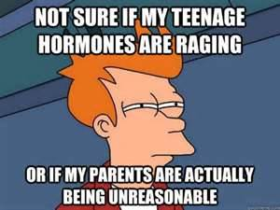
Understanding/Managing Your Emotions
What are some emotions you feel???
Make 3 columns.
1-List 5 emotions that are always positive for you in column 1
2-List 5 that you always experience as negative in 2
3- 5 that could be positive
or negative depending on the
situation in column 3

Slide 17
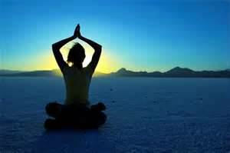
The “Big” four: Fear, Guilt and Anger, Stress
FEAR: Recognize your fear and figure out what to do to overcome it
GUILT: Think about the cause, admit the mistake, and make amends
ANGER: Think about the cause if its not obvious. Some ways to help manage are; relax, exercise, or talk it out.
STRESS: Find ways to manage it.

Slide 18
Dealing with difficult emotions
Some things to help:
Analyze the situation, get rid of the energy, scream, express your feelings, talk to someone, take a break, confront (remember to use “I” messages, take some time and space, don’t be hurtful, put things in perspective.
Feeling bad is normal, some people chose to avoid difficult situations by using defense mechanisms
Repression-pushing it out of your mind
Regression-reverting back to childish ways
Projection-put it onto someone else
Rationalization-make excuses
Compensate-make up for weaknesses

Slide 19
YouTube Video Controlling the Roller Coaster

Slide 20
Hallmarks of Good Mental Health
Positive Self-esteem
Satisfying Interpersonal Relationships
Academic Success
Having Future Goals
Making Good Choices
Ability to Delay Immediate Gratification
Resiliency

Slide 21
Video: Hallmarks of Good Mental Health

