Slide 1
Coping with Stress and Loss
Chapter 4

Slide 2
Vocab for lessons 1-3
Perception
Stressor
Psychosomatic response
Chronic stress
Relaxation response
Closure
Coping
Mourning
Traumatic event

Slide 3
What is Stress?
“You are stressing me out”
Stress is how we Perceive something and then how we react so we do have control!
What causes stress for some may not cause any stress for others

Slide 4
Your Body’s Response
Both your body and your mind will respond
There are three parts to the physical response:
Alarm- mind and body are in high alert known as the “FIGHT or FLIGHT” response
Resistance- if the stressor continues your body adapts
Fatigue- if stress is prolonged your body begins to tire and cannot manage at this point both physical and mental issues can take place in your body

Slide 5
Normal vs unhealthy
Normal Stress
It’s a good thing it can help to motivate or energize.
Comes and goes.
Shouldn’t affect your sleep, eating habits or social behavior for long periods.
Will not cause feelings of wanting to hurt yourself or escape problems.
Unhealthy Stress
So overwhelming you can’t take action
Makes you feel hopeless, worthless, and incapable of doing anything.
Affects sleeping, eating and social life for many days.
May cause feelings of depression, low-self esteem, and self-harm

Slide 6
Sources of Stress
Life Situations-school, friends, peer pressure, family, moving, breaking up
Environment-neighborhood, media, weather, war
Biological-body changes, illness, injury
Cognitive (thinking)-low self-esteem, appearance, not fitting in
Personal Behavior-busy, relationships, smoking, using alcohol or drugs, not getting enough sleep, poor nutrition

Slide 7
When Stress Becomes a Problem
Normal stress in small amounts is a good thing
Normal stress comes and goes
Stress is a problem when it becomes overwhelming, makes you feel hopeless or worthless, and makes you incapable of action
Chronic stress is associated with long term health problems that are beyond a person’s control

Slide 8
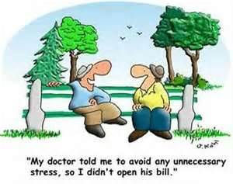
Stress Management TIPS
Use refusal skills
Plan ahead
Think positively
Avoid tobacco, alcohol or other drugs
Practice relaxation techniques
Redirect your energy
Seek support of others
Stay Healthy (get enough sleep, activity, and good food)
Pick your battles
Prioritize

Slide 9
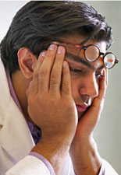
Personal stress buster test
1. Name two stressors in your life (be very specific, ie..don’t say school)
2. Explain the stress and why it causes you stress
3. Explain how this stress makes you feel, and how it impacts your overall wellness (seven dimensions)
4. Describe strategies you have tried to help you manage this stress that have been unsuccessful
5. Identify three to four healthy strategies that you would consider trying to reduce, manage or eliminate the stress
DUE NEXT CLASS PERIOD

Slide 10
Coping With Loss and Grief
What are some things that can cause us to feel loss or grief??
Acknowledge your loss, grieving is a common and natural reaction to any loss that brings on strong emotions.

Slide 11
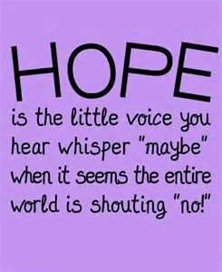
Steps in the Grieving Process
Denial or Numbness-difficulty accepting
Emotional Release-crying
Anger
Bargaining-promise to change
Depression
Remorse-how could it have been prevented
Acceptance-closure
Hope-look to the future

Slide 12
Coping
Traumatic Events:
Seek support
Try to resume your normal activities
Disruptive Life Changes:
Seek information
Accept and express your feelings
Try to keep the problem in perspective Take care of yourself

Slide 13
Divorce:
Express your emotions
Keep things peaceful
Ask your parents to be fair
Ask them to answer questions you might have about the divorce
Remember its not your fault, and there is no right way to divide your time between them

Slide 14
Coping Strategies
Healthy
Unhealthy
Learn coping skills
Live a healthy lifestyle, ie diet, exercise, sleep
Determining what can be changed about your situation and how you can do it
Learn how to accept what cannot be changed
Be patient with yourself and have realistic expectations
Accept that fear, anger and anxiety are normal emotions
Accept that experiencing even very painful emotions is part of being wonderfully human.
Find healthy ways to let your feelings out
Seek support
Seek a counselor if you feel you need extra help
Pretend the problem isn’t there
Avoid the problem
Deny your feelings
Keep your emotions bottled up
Blame yourself
Think that nobody else will understand
Take anger out on others
Isolate yourself from family/friends
Use drugs, alcohol or sex to numb yourself
Think that something is wrong with you

Slide 15
Coping With Disruptive Life Changes
Video

