Slide 1
Chapter 5 Mental and Emotional Problems

Slide 2
Vocabulary
Anxiety
Depression
Apathy
Mental Disorder
Stigma
Alienation

Slide 3
Stigma of Mental Illness
This year there are several new kids at your school. What might go through your head when you hear these statements about these classmates?
Your friend says:
1-You know why Jerry wears a baseball cap all the time? He has some kind of cancer and he lost all his hair after chemo. He barely has any hair.
2-Have you heard about Zoe? She has diabetes. She has to take insulin every day. She could die if she eats candy.

Slide 4
3-You know Manuel? He’s so allergic to bees that he has to carry one of those epi-pens to give himself an injection.
4-Guess what I heard about Jessica? She sees a therapist every week. I heard that she tried to kill herself last year.
5-You know James, the guy who is always goofing off in science class? He has ADHD. He goes to the nurse’s office every day to take his meds. If he misses a dose he turns into a psycho.
6-Did you hear about Arianna? She was in the hospital all summer. They say she went crazy, but I guess it’s under control now. Still, I’d be careful around her if I were you.

Slide 5
Stigma of Mental Disease
Just like people with physical illness, people don’t ask to be stricken with a psychological disorder. It just happens.
Mental disorders don’t indicate an emotional, spiritual or moral weakness on the part of the sufferer.
It is not acceptable to judge a person because of any mental or physical impairment.
If a person has been diagnosed with a mental illness in the past it doesn’t mean the person is suffering from the same illness today.
Someone in therapy is not “crazy”.

Slide 6
TEST YOUR KNOWLEDGE FACT OR FICTION
1- The vast majority of people with serious psychological disorders show their first symptoms after age 25.
2- A person who occasionally feels worried, anxious, sad or stressed is very likely to be suffering from an undiagnosed mental disorder.
3- People who suffer from depression often have a second psychological disorder as well
4- Psychological disorders cannot be cured since they come from the mind and not a “treatable” part of the body
5- Psychological problems will go away on their own
6- Mentally ill people are frequently violent and dangerous
7- Eating disorders like Anorexia and Bulimia can be deadly
8-Anxiety disorders can be properly diagnosed only in adults, since its normal for teens to be anxious during adolescence

Slide 7
ANSWERS ARE……
1- The vast majority of people with serious psychological disorders show their first symptoms after age 25.
FICTION: Although most adolescence are healthy, 50% of all serious mental illness begin by age 14 and 75% are present by age 25
2- A person who occasionally feels worried, anxious, sad or stressed is very likely to be suffering from an undiagnosed mental disorder.
FICTION: Everyone feels these at times. But for people with a mental illness they don’t go away, they make it hard to focus on school, hold down a job, maintain friendships and enjoy life.
3- People who suffer from depression often have a second psychological disorder as well
FACT: Disorders often co-exist. About 2/3 of teens also suffer from substance abuse, anxiety disorder or antisocial behavior.

Slide 8
4- Psychological disorders cannot be cured since they come from the mind and not a “treatable” part of the body
FICTION: They can be treated by therapy, medication or both
5- Psychological problems will go away on their own
FICTION: They do not just go away, getting an accurate diagnosis and effective treatment is very important
6- Mentally ill people are frequently violent and dangerous
FICTION: Very few are dangerous to society. They are more likely to be victims

Slide 9
7- Eating disorders like Anorexia and Bulimia can be deadly FACT: Anorexics die at a rate 12 times higher. Causes of death are due to complications like; cardiac arrest, malnutrition, electrolyte imbalance and suicide. Bulimics are at risk for heart failure 8-Anxiety disorders can be properly diagnosed only in adults, since its normal for teens to be anxious during adolescence FICTION: Anxiety disorders are the most common mental illness among children and teens. Up to 13% of 9-17 yr olds have one

Slide 10
Facts of Mental Illness
According to the National Institute of Mental Health, about half of all Americans will have a psychological disorder at some point in their lives.
50% of all serious disorders begin by age 14, and 75% are present by age 25
Psychological disorders often co-exist. At least 60% of people battling either mental illness or substance abuse are battling both conditions at the same time
In extreme conditions it can lead to suicide. Suicide is the 3rd leading cause of death among teens

Slide 11
Causes of Mental Illness
Biological factors: Genetics, abnormal functioning of regions of the brain, brain damage, prenatal development problems of the brain, substance abuse, poor nutrition and exposure to toxins.
Severe Psychological Trauma: Emotional, physical or sexual abuse, loss of a loved one, neglect, poor ability to relate to others.
Environmental Triggers: Death, divorce, dysfunctional family, low self-esteem, substance abuse by the person or a family member, responses to media messages.

Slide 12
What are some types of Mental Disease???
Groups of two, list as many mental diseases as you can.
You have 4 minutes.
Go….

Slide 13
Anxiety disorders
13 out of 100 kids ages 9-17 experience anxiety disorders, girls are diagnosed more often than boys
Types:
Generalized- extreme, continuous unrealistic worry about everyday things. Someone feels tense constantly.
Phobia- unrealistic and excessive fear of certain situations or objects.
Social Phobia/Social Disorder- persistent fear of judgment and humiliation. Terrified of being criticized or judged.

Slide 14
Anxiety Disorders cont….
Panic Disorder- panic attacks that occur without any cause.
Obsessive-Compulsive Disorder (OCD)- sufferers become trapped in a pattern of repetitive thoughts and behaviors.
Post-Traumatic Stress Disorder (PTSD)- after witnessing a traumatic event, suffers experience that event over and over through strong memories, flashbacks, or troublesome thoughts. They may over react to when startled or have difficulty sleeping.

Slide 15
Depression
What- 1 in 5 will experience before adulthood. Young people with depression have a hard time dealing with everyday activities and responsibilities.
Difference between being sad and depressed is: depression is more severe, lasts at least two weeks and includes several symptoms. It affects how you behave, interact, and feel about yourself.

Slide 16
Symptoms of Depression
Physical
Change in eat or sleep patterns
Frequent complaints of head or stomachaches
Low energy
Mental
Poor concentration
Thoughts of suicide
Thoughts of self-destructive behavior
Difficulty making decisions

Slide 17
Emotional
Frequent sadness, tearfulness or crying
Empty or hopeless feelings
Feelings of inadequacy, unworthiness or guilt
Increased irritability, anger or hostility
Behavioral
Decreased interest in
favorite activities
Difficulty with relationships
Frequent absences or poor performance in school

Slide 18
Three Types of Depression
Major Depression- can occur several times in one’s life. Gets in the way of work, sleep, study, and enjoyment of life.
Dysthymia- less severe, but long lasting. Can keep a person from functioning well, feeling good, or experiencing joy.
Bipolar Disorder- least common. Cycles of mood swings, alternating between mania (severe high) to depression (severe low).

Slide 19
Causes of Depression
Genetics: runs in families
Triggers:
loss of a loved one
divorce
learning or behavioral problems
physical or emotional abuse
trauma
Treatment:
80% of people can be helped with counseling and medication or both

Slide 20
Video: Teen Depression

Slide 21
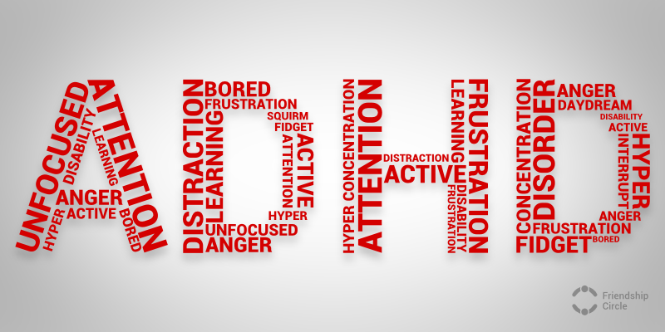
ADHD
Symptoms:
Difficulty paying attention
Overly active or impulsive
Hyper focused
Causes: Genetics
Treatment: includes medication and behavioral therapy. ADHD can only be managed not cured.

Slide 22
Eating disorders
Types:
Anorexia- starvation of one’s self due to unrealistic body image.
Bulimia- cycles of binging and purging. They may vomit, take laxatives or diuretics.
Binge Eaters- uncontrolled eating in large quantities in a short period of time, often followed by shame and self-hatred.
EDNOS- people who struggle with disordered thoughts, feelings or behaviors about eating but don’t fit strictly into one category or the other.
Causes: No exact causes, most think combo of biological and environmental
Treatment: medical care, counseling

Slide 23
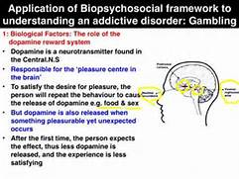
Impulse control disorders
People cannot control the urge to hurt themselves or others
Types:
Kleptomania- unplanned theft
Cutting- repetitive cutting on body parts
Pyromania- setting fires
Excessive Gambling or Shopping

Slide 24
Other Impulse Disorders:
Conduct Disorder- People who violate others rights and can’t follow social rules
Examples: stealing, lying, cheating, aggression, violence, truancy, arson and vandalism
Substance Abuse (addiction)- 60% are also diagnosed with a second disorder. May permanently change the way the brain functions.
Leads to serious harmful consequences that can last a lifetime
Treatment: treatment programs, detox, medication, therapy, AA or NA programs

Slide 25
Schizophrenia
Person loses contact with reality
Symptoms: delusions, hallucinations and thought disorders.
Treatment: professional help and medication

Slide 26
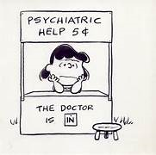
Treatments for Mental Disorders
Drug therapy
Electroshock therapy
Psychotherapy, individual, group or family
Behavior therapy such as relaxation training
Hypnotherapy

Slide 27
Video: Common Psychological Disorders of Adolescence

Slide 28
FAMOUS PERSON PROJECT
CREATE A POWER POINT BIOGRAPHY OF YOUR PERSON
ANSWER THE FOLLOWING QUESTIONS:
1-What is the person famous for, what is the person’s greatest achievement in life?
2-What psychological disorder do/did they have? Explain what the disease is.
3-When did it start? What symptoms did they have? How did the illness affect the persons thoughts, feelings and behaviors?
4-Did the disorder cause the person difficulty in his or her life? In what way?
5-Did having a psychological disorder affect the person’s ability to achieve success?
6-How has the individuals life changed as a result of the disorder?
7-Did the person seek treatment? If so, what kind?
8-What has the person said publicly, regarding his/her disorder?

Slide 29
Grade is based on: Answer the questions Creativity of slide show Presentation of show Show not to exceed 5 min time limit Copy of the slides turned in Presentation/copy of slides is due on: Next Day after we take the Mental Health Unit test or it is late and down graded even if you do not present that day!

Slide 30
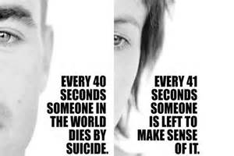

Slide 31
Suicide: Myth and Facts
Myth: It’s normal for teens to be moody, teens don’t suffer from “real” depression.
Fact: Depression affects all ages, races, and ethnicities.
Myth: Teens who claim to be depressed are weak and just need to pull themselves together.
Fact: Depression is not a weakness, but a serious health disorder which needs treatment just like any other disease.
Myth: People who talk about suicide won’t really do it.
Fact: Almost everyone who dies from suicide has given some clue or warning. Do not ignore threats.

Slide 32
Myth: If a person is determined to kill themselves, nothing is going to stop them.
Fact: Even the most severely depressed person has mixed feelings about death, wavering until the very last moment. Most don’t want death, they just want the pain to stop.
Myth: People who commit suicide are people who were unwilling to seek help.
Fact: Studies have shown that ½ had sought help within six months before their deaths.
Myth: Talking about suicide may give them the idea.
Fact: You don’t give a suicidal person morbid ideas by talking about suicide. Discussing it openly is one of the best things you can do.

Slide 33
Suicide Prevention
Wisconsin is the #3 state for suicide among teens in the US
1 in 8 teens in WI have contemplated death
Suicide Risk Factors: 90% are suffering from depression or another mental disorder, or have a history of drug/alcohol abuse
YRBS survey for MPS:
13% Have thought about it
11% Have made a plan for it
6% Have attempted it
2% Have need medical attention for the attempt
Warning signs of Depression could be an indicator

Slide 34
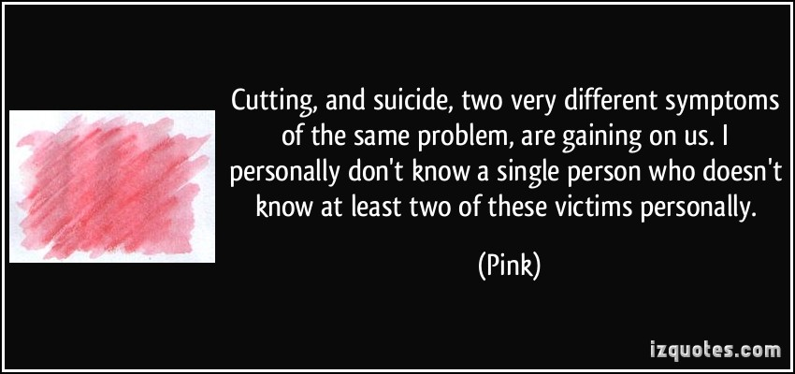
Risks Factors For Suicide
Prior attempts
Untreated mental illness
Crisis
Substance abuse
Access to lethal means
Exposure to suicide in the media
Who is most likely to complete a suicide attempt?

Slide 35
Warning signs of Suicide:
EARLY SIGNS:
Withdrawal from friends/family
Loss of interest
Acute personality changes
Difficulty concentrating
Decline in school work, or recreational performance
Dramatic changes in personality, hygiene, or appearance
Changes in eating/sleeping patterns
An unusual obsession with death; Writing poems, lyrics or diary entries that talk about death

Slide 36
LATE SIGNS:
Direct or Indirect statements
Impulsive, irrational behavior
Giving away personal belongings
Violent actions, rebellious behavior, or running away
Verbalizing threats
Statements like “I won’t be missed”
Use or increased use of substances
Talk or write about the plan
Make a will

Slide 37
Letter From Paula
Draw a circle- inside the circle identify the feelings and emotions that you believe Paula may have had when she wrote the letter.
Outside the circle-identify the warning signs or red flags that give evidence to show Paula is perhaps asking for help for her depression and/or possible suicide.

Slide 38
How Can You Help
ACT
Acknowledge: admit that you are seeing signs of depression or suicide in a friend that is serious. Don’t say: “Get over it” or “move on”.
Care: Let the friend know that you care about him/her, and that you are concerned that he/she needs help you cannot provide. “I am worried about you. I don’t want you to get hurt.”
Tell: Inform a trusted adult, either with your friend or on his/her behalf. “Lets go talk with some.”

Slide 39
Suicide Intervention Skills
Share your concern: Listen to them. Show them that you care.
Ask the question: Are you considering killing yourself?
Safety: Ask for the modality, as long as YOU maintain your safety. Do they have a plan? Is it lethal, specific and available?
Stay with them!! Peak of impulsivity usually only lasts a few minutes to a few hours.
Tell Someone!!!!! Adult, counselor, parent, pastor, counselor, doctor, teacher.

Slide 40
Avoid these things
Don’t shame: You’ve got to get over this, move on, you’re too sensitive, etc…
Don’t delay: Get help right away
Don’t blam
Don’t give up: suicide is not a destiny. When people make through the crisis they usually go on to lead healthy, productive lives
Don’t do it alone: get an adult to help

Slide 41
Do I Need Therapy?
Persistant negative feeling that you can’t shake (anger, sadness, worry)
Strong emotions that interfere with life/school
Desire to talk to someone other than your friends/family
Realization that your life is off track
Going through a rough time
Feeling overwhelmed
Major change or a traumatic event
Hurting other people or yourself
Feeling worthless, guilty or anxious all the time

Slide 42
NATIONAL HOTLINES
1-800-SUICIDE 1-800-784-2433 National Hopeline Network
1-800-273-TALK 1-800-273-8255 National Suicide Prevention Lifeline •LifeLine Chat•
CrisisChat.org Online Emotional Support Hours Vary - Approx 12hrs daily / 7 days
1-877-YOUTHLINE 1-877-968-8454 Youth America Hotline - Counseling for Teens by Teens
1-866-488-7386 The Trevor Project Crisis intervention & Suicide prevention For lesbian, gay, bisexual, transgender, and questioning youth Trevor Chat • Trevor Space

Slide 43
DVD
FRIENDS FOR LIFE
PREVENTING TEEN SUICIDE

Slide 44
Pat on the back activity
Get five peers to write an honest, sincere and positive comment on your sheet
When you have five fold your sheet in half and sit down without reading
When everyone has sat down, read and reflect
Write down 3 to 5 words describing how this makes you feel

Slide 45
Evidence and Practice for Unit 2
Evidence:
Stress Test
Mangeing Stress/Mental and Emotional Problems
You are valuable
Chapter 3 Review
Chapter 4 Review
Chapter 5 Review
Practice
Packet for Unit 2

Slide 46
Mental Health Review
www.quizlet.com
MsTHealth
30 minutes to do the reviews on this site. Test next class.

