Slide 1
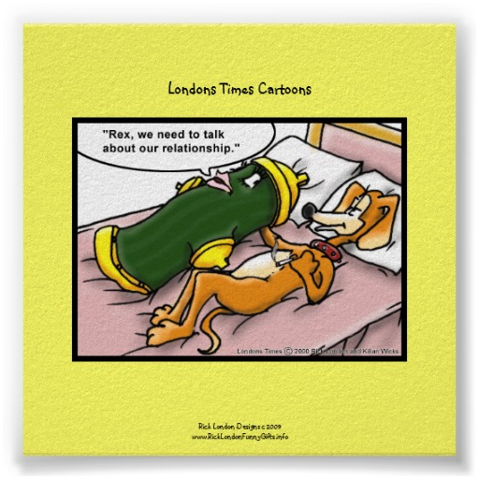
Human Growth
Healthy Relationships

Slide 2
Five Stages of a Healthy Relationship
Initial Attraction – get to know each other
Friendship – find things in common
Close Friendship – “dating” stage
Deep Friendship – confide, trust and support “going steady” stage
Lifelong Love – commit to each other for life

Slide 3
How long should it take to go through the five steps?
How long before teens think they are in love?
If the relationship is healthy, how long before you really love someone? What stage is this?
In a healthy relationship where does sexual activity occur?
Where does it occur for too many teens?
Why doesn’t a relationship last if sex happens too soon?
What is that relationship based on?

Slide 4
The “LOVE” Triangle
PASSION-INTIMACY-COMMITMENT= REAL LOVE
Groups 1/4: INTIMACY
Groups 2/5: PASSION
Groups 3/6: COMMITMENT

Slide 5
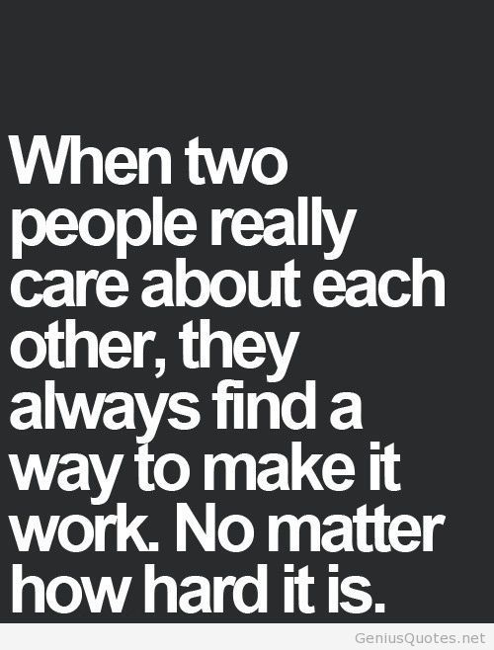
Characteristics of a Successful Marriage/Relationship
Compatibility
Friendship
Similar interests
Similar goals
Make a relationship a priority
Ability to communicate
Shared responsibilities
Physical attraction
Mutual concern
Mutual respect
Ability to compromise
Others?????

Slide 6
Relationships Without The Three Components
Non Love (No components)- an acquaintance
Romantic Love (Passion & Intimacy) – a couple feels close and physically attracted to one another
Dependant Love (Intimacy)- closeness but no control over commitment
Empty Love (Commitment)- maintains a relationship but no shared feelings of closeness or attraction

Slide 7
Relationship types cont…
Fantasy Love (Passion & Commitment)- physical attraction and commitment, but no intimacy
Infatuation (Passion)- physical attraction without commitment
Friendship (Commitment & Intimacy) – people who have an emotional bond and wish to maintain it
Real Love (Commitment, Passion & Intimacy)

Slide 8
Infatuation or love???
Write “Love” on the far top right
Write “Infatuation” on the far top left
Divide the center section into three columns
In space one list all the ways that infatuation and love are the same, you have 5 mins.
In space two list all the ways that they are different, you have 5 min.
In space three note the top two similarities and differences that you feel are the most important for someone to understand the two concepts

Slide 9
Do you now know the difference?
Object of affection is likely to be a suitable person who meet the core issues of the individual.
Feelings of guilt, insecurity, and frustration are frequent.
Broadly involves the whole personality.
Can occur soon after a previous relationship is over
Little change in the relationship over time.
Joy is in many common interests and in each other.
Tends to be self-centered and restricted.
Is often the term used to refer to current attachment.
Physical attraction is often the only factor in the relationship

Slide 10
Boredom is frequent when sexual excitement wears down.
Grows through the years with emotion maturity.
Is the term often times applied to the past attachments.
Focuses frequently on quite an unsuitable person.
Loyalty centers in mutual commitments and involvement.
Relationship changes and grows with ongoing associations.
Shallow sensations come and go.
Deepening feelings provide steady warmth as more of life is shared.
Problems are tackled and worked out as they arise.
Partners depend upon external amusement for fun.
You see the person for who they are, not a romantic myth.
Is associated with feeling s of self-confidence, trust and security.
Don’t depend on the other person for happiness
May slowly develop again after a previous relationship is over
Little mutual exportation of personality, values , and aspirations
Tends to be highly individual, unique, and person centered
May exploit the other person
Is a poor basis for marriage
Has a protective, nurturing, caring concern for the other person
Jealousy is often shown.

Slide 11
ABUSIVE RELATIONSHIPS

Slide 13
3 stages to abusive relationships
Happy or Romantic stage- relationship is going well, the partner is often loving and attentive. If abuse has just occurred, the partner is often apologetic and asks for forgiveness.
Tension-building stage- increased conflict occurs during this stage.
Explosive stage- stage where actual abuse takes place.

Slide 14
Warning Signs
INTIMIDATION: yelling, threating tone, talking down, threating to hurt you or themselves, destroying things
SEXUAL ABUSE: bragging, comparing you to others, flirting, use of alcohol or drugs to get sex, pressuring, rape
PHYSICAL ABUSE: holding so you can’t leave, slamming into wall/locker, hurting where bruises don’t show, grabbing, slapping, hitting, shoving, punching, kicking

Slide 15
Cont….
THREATS: saying you can’t live without, telling partner they will leave if you don’t do something, threating to find someone else, saying they will commit suicide
DOMINATION: treating you like a baby, property or servant, making all the decisions, having expectations nobody can meet, controlling who your partner spends time with, setting all the rules

Slide 16
And there’s more…..
HUMILIATION: put downs, name calling, constant criticism, guilt, embarrassing them
POSSESSIVENESS: jealousy as a sign of love, accusations of cheating, not letting partner have friends, telling them how to…
MINIMIZATION AND BLAME: not accepting responsibility for actions, telling partner everything is their fault, acting like abuse is OK

Slide 17
Reagan’s Own
http://www.jsonline.com/story/news/crime/2016/10/14/domestic-abuse-survivor-urges-others-get-help/91690234/

Slide 18
True or False????
After paying for a fancy dinner on a first date, it’s not a big deal for someone to make their date kiss them even if the date says they do not want to.
If a someone is abusive when they are drunk or high, it doesn’t count as abuse.
It is common for an abuse victim to blame themself for what happened.
Jealousy is always a sign of true love.
It’s not OK for people to hit each other even when they are “out of control”.

Slide 19
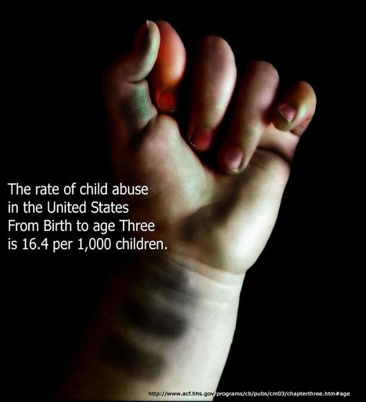
T or F
It’s OK to tell the person who you are dating who they can and cannot talk to.
Only boys commit dating violence toward girls.
Repeatedly calling a friend or partner bad or mean names is a type of abuse.

Slide 20
Social Norms Quiz
1-Do you know someone who has been hit, slapped, or physically hurt by their boy/girlfriend on purpose?
2-Do you know someone who has been repeatedly “put down” by their boy/girlfriend?
3-Do you know someone who has been “threatened” by their boy/girlfriend?
4-Do you know someone who has openly said that “he/she should put out if I spend a lot of money on a date”?

Slide 21
5-Do you know someone whose boy/girlfriend tried to control who they spend their time with, how they dress or what they do?
6-Do you know someone whose boy/girlfriend forced or pressured him or her to take part in some kind of sexual activity?
7-Do you know someone who has slapped or physically hurt their boy/girlfriend on purpose?
8-Do you think friends can help friends who are being hurt or controlled their boy/girlfriend?
9-Do you think friends can help friends who are hurting or controlling their boy/girlfriend?
10-Do you think dating violence incidents are more likely to occur to females?

Slide 22
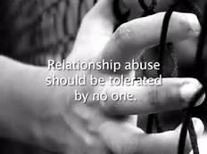
Dating Violence what are the facts?
In a 2009 survey of MPS high school students, what % of females reported having been forced (verbally or physically) to take part in sexual activity?
a. 14.9%
b. 12.2%
c. 13.9%
d. 12.0%

Slide 23
2. In a 2009 survey of MPS high school students, what % of males reported having been forced (verbally or physically) to take part in sexual activity?
a. 12.2%
b. 14.3%
c. 10.2%
d. 10.0%

Slide 24
3. In a 2009 survey of MPS high school students, what % of females reported having been hit, slapped, or physically hurt by their boyfriend or girlfriend on purpose?
a. 14.6%
b. 14.2%
c. 13.8%
d. 16.6%

Slide 25
4. In a 2009 survey of MPS high school students, what % of males reported being hit, slapped, or physically hurt by their girlfriend or boyfriend on purpose?
a. 17.2%
b. 5.7%
c. 11.8%
d. 14.2%

Slide 26
5. Of females victimized by date rape, what % are between the ages of 14 and 17 years old?
a. 61%
b. 43%
c. 24%
d. 38%

Slide 27
Its Not Normal, Its Not Right

Slide 28
Sexual Abuse
True or False?

Slide 29
TRUE OR FALSE???
1-Victims provoke sexual assaults when they dress provocatively or act in a promiscuous manner.
2-If a person goes to someone’s room or house or goes to a bar, he or she assumes the risk of sexual assault. If something happens later, he or she can’t claim that he or she was raped or sexually assaulted because he or she should have known not to go to those places.
3-It’s not sexual assault if it happens after drinking or taking drugs.
4-Most sexual assaults are committed by strangers. It’s not rape if the people involved knew each other.
5-Rape can be avoided if people avoid dark alleys or other “dangerous” places where strangers might be hiding or lurking.

Slide 30
6- A person who really has been sexually assaulted will be hysterical.
7-If sexual assault is not immediately reported to the police it must have been ok.
8-Only young, pretty women are assaulted.
9-It’s only rape if the victim puts up a fight and resists.
10-Someone can only be sexually assaulted if a weapon was involved.
11-Rape is mostly an inter-racial crime.
12-As long as both partners are under the age of 18 neither can be charged with a crime.

Slide 31
Personal Perspectives On Relationships
Place each behavior on the continuum based upon your groups values and beliefs. Make sure to have a discussion.
Red-Yellow-Green light activity

Slide 32
Things You Can Do To Avoid Date Rape
Set sexual limits, Talk openly about sex, and keep talking as you get further into your relationship
If things start to get out of hand be loud or leave
Be aware of situations you don’t feel relaxed or in charge, trust your gut
Be wary of situations with drugs/alcohol involved
Go on group or double dates
Have your own transportation
Avoid secluded places
Think about the pros and cons of dating older people
Socialize with people who share your values
Don’t leave someplace with someone you just met
Always get your own drink and watch it being poured, don’t leave it unattended, don’t drink it if it tastes funny

Slide 33
What to do if someone tries to force sexual activity on you
Say no strongly, don’t smile or act polite
Say something like “stop it, this is rape”
Assess the situation and figure out how you can escape
Act quickly, the longer you stay in the situation the fewer options you will have to get out
Ask yourself if it is safe to resist. Women who fight back initially, who hit and scream, have a higher percentage of avoiding the successful completion of an assault
Shout fire instead of help, more people will tend to respond
Use intimidation, lie (say you have a STD)

Slide 34
Sexual Assault and Abuse Information
Sexual violence is any act (verbal or physical) which breaks a person’s trust or safety and is sexual in nature.
National Facts
- 38.3% of total rapes were reported to the police
- 56.1% of stranger rapes and 28.3% of non-stranger rapes were reported.
-34% happened to people below the age of 12
33% between the ages of 12-17, and 14% between the ages of 18-24
-1 in 7 victims is under the age of 6, 1 in 4 under the age of 12 are boys
-50-75% of women in substance abuse treatment programs are survivors of abuse

Slide 35
Wisconsin Facts
5,618 sexual assaults were reported in 2004
85.9% of victims were female, 93% of the offenders were male
88.9% of all sexual assaults were by someone the victim knew, only 6.4% were by a stranger
58.5% of all assaults took place in the victim’s or the offender’s home
77% of all victims were juveniles, over 70% were 15 or younger
Avg age of the offender was 24
In 2004 someone was sexually assaulted once every 1 hour, 33 minutes and 33 seconds

Slide 36
Teens and the Law Pre/Post test
1. Under Wisconsin law how old do you have to be to legally consent to sexual intercourse?
2. A 1st degree sexual assault (a class B felony) is sexual contact or intercourse with anyone under the age of _____?
3. How many years of jail time can someone get for being convicted of a class B felony?
4. A second degree sexual assault (class C felony) is sexual contact or intercourse with anyone under the age of _____?

Slide 37
Cont.….
5. How many years of jail time can a person get for a class C felony?
6. Can two 16 and 17 year old students be convicted of having sexual intercourse?
7. If you are convicted of a sex crime, what might you have to register as?
8. If you are registered as sex offender, who has access to that information?
9. If a 17 yr old has sex with a 15 yr old what can they be convicted of?

Slide 38
Answers….
1. Under Wisconsin law how old do you have to be to legally consent to sexual intercourse? 18
2. A 1st degree sexual assault (a class B felony) is sexual contact or intercourse with anyone under the age of? 13
3. How many years of jail time can someone get for being convicted of a class B felony? 40
4. A second degree sexual assault (class C felony) is sexual contact or intercourse with anyone under the age of? 16

Slide 39
How many years of jail time can a person get for a class C felony? 25
Can two 16 and 17 year old students be convicted of having sexual intercourse? YES
If you are convicted of a sex crime, what might you have to register as? SEX OFFENDER
If you are registered as sex offender, who has access to that information? EVERYBODY
If a 17 yr old has sex with a 15 yr old what can they be convicted of? CLASS C FELONY

Slide 40
Sex offender registry
What is the Sex Offender Registry?
An accessible database maintained by the Dept. of Corrections to help protect the public by monitoring and tracking sex offenders.
Who is placed on the registry?
Individuals convicted of a sex crime who are residing in the state of WI, sexual predators, people found not guilt by reason of mental defect, and people found guilty of sexually motivated crimes.

Slide 41
What is a sex crime?
Over 30 crimes are defined as sex crimes that require registration
Are there exceptions?
Yes, in general it exempts offenders under 19 who commit certain crimes with no violence.
How long must they stay on the registry?
In general 15 years, some have to for life.

Slide 42
Who can access?
Anyone
Where do I find
the registry?
1-800-398-2403
http://offender.doc.state.wi.us/public

Slide 43
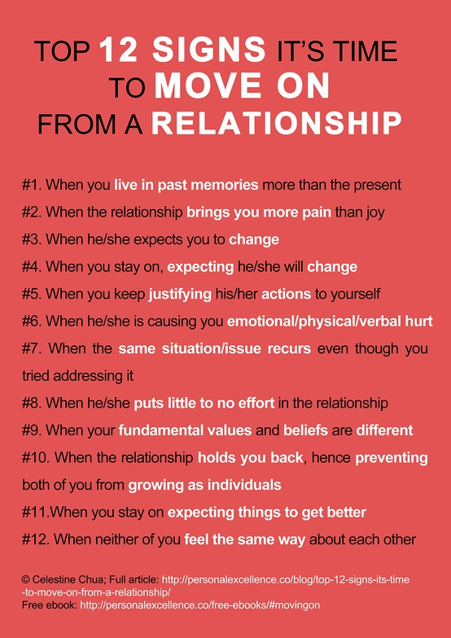
Video
Ten Signs
of
Relationship
Abuse

