Slide 1
When is sex appropriate??

Slide 2
ABSTINENCE
DUE NEXT CLASS: Write a paragraph explaining what abstinence is, what your views on it are, what are the pros and cons of it. Why you thing people chose to have sex at such a young age? And if you chose to be abstinent from sex, why or why not?
Top Ten Reasons Worksheet

Slide 3
ABSTINENT
Abstinence is a self-enforced restraint from indulging in bodily activities that are widely experienced as giving pleasure. Most frequently, the term refers to sexual abstinence, or abstention from alcohol or food

Slide 4
TOP TEN REASONS TO BE ABSTINENT
10-To keep your reputation
9-So you can know the person likes you for you
8-So your parents won’t be disappointed
7-Because you are not ready for sex yet
6-To save yourself from all of the emotional baggage ten sex can have (regret, doubt, fear, anger, feeling betrayed…)

Slide 5
“Someone who is worthy of your love will never put you in a situation where you feel you must sacrifice your dignity, integrity or self-worth to be with them.” <unknown>
5-You want to focus on your education or future career
4-Because you don’t want an STI
3-You want to save sex for that one special person and/or marriage
2-Because you don’t want to get pregnant
1-Because you want to uphold your religious or moral values

Slide 6
Abstinence means different things to different people.
Abstinence can mean not having any physical contact
Abstinence can also mean having some physical contact but no sexual activity that involves the genitals (e.g., masturbation, sexual intercourse)
How does it work?
To be abstinent, you and your partner have to set some limits. These limits are different for everyone
You can’t get pregnant or get a sexually transmitted infection (STI) if you are abstinent - with no genital to genital, skin to genital and body fluid to genital contact
You CAN get pregnant without having sexual intercourse if sperm is near the opening of the vagina. You can get some STIs by touching the genital area of your partner

Slide 7
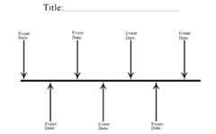
WHEN IS IT APPROPRIATE?
Group A = parents Group B = teenagers
Both groups decide where on the timeline continuum each item should be located.

Slide 8
BAG OF BEANS ACTIVITY

Slide 9
Contraceptive Methods Reliability Worksheet

Slide 10
AND THE WINNER IS??????
1- Abstinence
2- Implants
3- Sterilization
4- Patch or Ring
5- Pill
6- IUD
7- Condom
8- Diaphragm/Cervical Cap
9- Spermicidal Foam
10- Rhythm/NFP
11- Withdrawal

Slide 11
Why Do Unintended Pregnancies Happen?
Embarrassed to talk about sex with partner or to get birth control supplies
Not knowing or understanding about using birth control to prevent pregnancy
Individual or religious beliefs about birth control
Birth control method not used correctly or consistently
Spontaneous act and not prepared
Use of substances that affect decision making (alcohol/drugs)
Difficulties accessing health care
Birth control supplies are too expensive

Slide 12
Contraceptive Myth or Fact
Wearing two condoms is better than just one
Having sex standing up will prevent the sperm from swimming up the fallopian tubes
A female cannot get pregnant the first time she has intercourse
Douching, showering or bathing can prevent pregnancy
A female cannot get pregnant if the male pulls out before he ejaculates
Use saran wrap or a balloon if you can’t find a condom
Latex condoms are effective if stored in a wallet or car for months
A virgin cannot get an STI
Condoms decrease sensation and hence reduce pleasure
False
False
False
False
False
False
False
False
False
False

Slide 13
Categories of Contraception
Barrier
Hormonal
Other
Prevent egg and sperm from meeting
Alter a woman’s reproductive cycle
IUD, rhythm method, sterilization, emergency contraception

Slide 14
BARRIER METHODS
Condoms Male/Female
Diaphragm/Cervical Cap
Spermicide

Slide 15
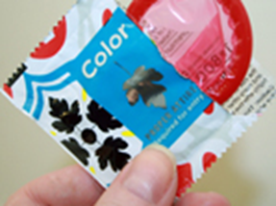
Male Condom
Provides a barrier for skin to skin contact and body fluids which can help protect against pregnancy and STI
Available at pharmacies, grocery stores and health clinics
Use a condom for oral, vaginal and anal sex or when sharing sex toys
Most condoms are latex. Non-latex types include lamb skin, polyurethane, and polyisoprene (synthetic rubber)
Check expiry date and keep in dark, cool place
Do not use with oil-based products like Vaseline, baby oil or hand cream. This increases the chance of the condom breaking
Use a new condom every time you have sex. Never use two condoms at once

Slide 16
Type: MALE CONDOM
How it works: A sheath that covers the erect penis and collects sperm when released, preventing semen from entering the vagina
Failure rate: One of the highest failure rates of all, 15 out of 100 will get pregnant. Consistent use provides lower failure rates, 2%.
Protection from STD’s: Latex condoms are effective against most STD’S. Natural skin are not. For increased protection use with another contraceptive method (DUAL CONTRACEPTION)
Benefits: Easy to obtain, low cost, low side
effects
Risks: Allergies

Slide 17
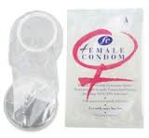
Type: Female Condom
How it works: A lubricated synthetic pouch that lines the vagina. Prevent semen from entering the vagina
Failure rate: Highest failure rate of all, 21 out of 100 will get pregnant, with experience drops to 2%
Protection from STD’s: Effective
Benefits: Easy to obtain, low cost, low side effects
Risks: Allergies

Slide 18
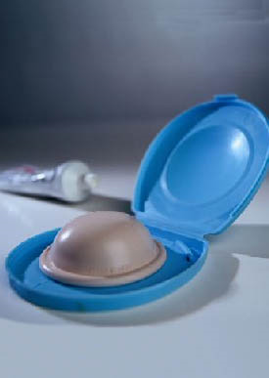
Type: Diaphragm
Description: A shallow silicone cup inserted into the vagina to prevent pregnancy
How it works: Diaphragms prevent pregnancy by keeping sperm from joining with an egg. In order to be as effective as possible, the diaphragm must be used with spermicidal cream, gel, or jelly. The spermicide stops sperm from moving. Must be fitted by a
Dr.
Failure rate: 17% inexperienced, 2% experienced
Protection from STD’s: NONE
Benefits: Using a diaphragm is safe, simple, and convenient, reusable
Risks: Allergies, UTI, abnormal pap test, toxic shock
Cost: Diaphragms average from $15 to $75.

Slide 19
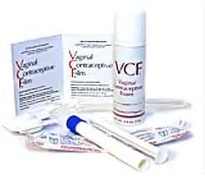
Type: Spermicidal Foam
Description: Foam or jelly used alone or with a cervical cap/diaphragm, kills sperm on contact
How it works: A substance that prevents pregnancy by stopping sperm from moving
Failure rate: Used alone 20 to 30%
Protection from STD’s: NONE, may even lead to increased risk
Benefits: Over the counter, low cost
Risk: allergies, increased risk of STD

Slide 20
Hormonal Contraception (Pill/Patch/Vaginal Ring/Implant/Shot)
How do they work?
Stop the release of a mature egg
Thicken cervical mucus making it difficult for sperm to get to the egg
Change the lining of the uterus making implantation difficult

Slide 21
SIDE EFFECTS OF ALL HORMONAL METHODS
Irregular periods
Weight gain
Breast tenderness
Nausea
Mood changes
Headaches

Slide 22
Facts
Takes about 7 days before it begins to work
Use alternate forms of contraception during that time
Should not be used by women who smoke: increases blood clots, stroke, heart attacks and high blood pressure

Slide 23
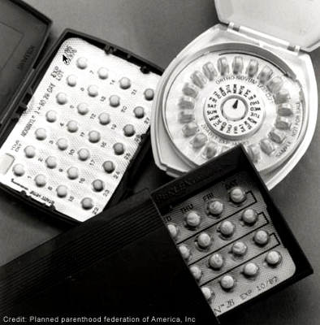
Type: BIRTH CONTROL PILLS
How it works: Prevent ovulation
Failure rate: If taken perfectly, (no missed pills) pregnancy is uncommon- 1-2% experienced, 5-8% not experienced
Protection from STD’s: NONE
Benefits: Lower the chance of getting ovary and uterus cancer, help with acne, cramps and bleeding during periods.
Cost: About $15–$50 each month

Slide 24
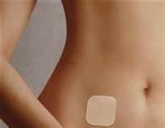
Type: Patch or Ring
Description: Transdermal patch worn on body
How it works: Secretes hormones into the body to prevent pregnancy
Failure rate: 1-2%
Protection from STD’s: NONE
Benefits: No surgery, must change weekly compared to daily for pill
Cost: About $15–$80 a month

Slide 25
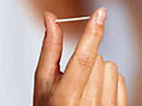
Type: Birth Control Implant (Implanon and Nexplanon)
How it works: Releases a hormone that keeps an egg from leaving the ovaries. It also makes a woman's cervical mucus thicker. This keeps sperm from getting to the eggs.
Failure rate: 1-2%
Protection from STD’s: NONE
Benefits: Constant BC, don’t have to remember to take anything.
Cost: The cost of the exam, the implant, and insertion ranges from $400–$800. Removal costs between $100 and $300.

Slide 26
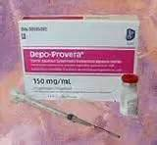
Type: Depo Shot
Description: Injection from a DR into arm or buttocks
How it works: Hormones used to disrupt pregnancy
Failure rate: 1%
Protection from STD’s: None
Benefits: Prevents pregnancy for up to 14 weeks
Cost: Depends on insurance $20-700

Slide 27
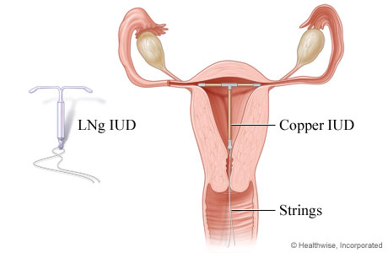
Type: IUDS
Description: 2 inch T-shaped device placed through the cervix into the uterus
How it works: Prevents sperm from reaching the fallopian tube, also prevents the egg from implanting on the wall if it is fertilized.
Failure rate: 1 per 100
Protection from STD’s: NONE
Benefits: Last for years without thought, can be removed if woman wants to get pregnant.
Cost: Between $500 and $1,000 up front, but lasts up to 12 years

Slide 28
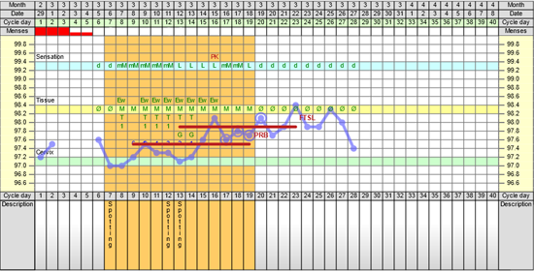
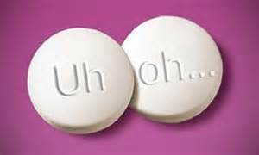
Other Methods

Slide 29
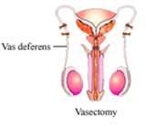
Type: Sterilization
How it works: Male- Vasectomy: clip vas deferens, Female- Tubiligation: clip fallopian tubes
Failure rate: <1%
Protection from STD’s: NONE
Benefits: Nothing to remember to take or do
Risks: Same as with any surgery, not much success if wanted to reverse it
Cost: Women- between $1,500 and $6,000 Men- $350 to $1,000

Slide 30
Type: Withdrawal - also called coitus interruptus or the "pull out method”
How it works: A man who uses withdrawal will pull his penis out of the vagina before ejaculation
Failure rate: 27% WORST METHOD OF BIRTH CONTROL
Protection from STD’s: NONE
Benefits: All natural
Cost: None (UNLESS YOUR TIMING IS BAD)

Slide 31
Type: Natural Family Planning or Fertility Awareness-Based Methods (FAMs)
Description: Charting your fertility to help prevent pregnancy
How it works: To prevent pregnancy, women can abstain from vaginal intercourse on their fertile days.
Failure rate: 2-9% experienced, 20% if not
Protection from STD’s: None
Benefits: They cost very little. They are safe. They can be stopped easily to plan a pregnancy. Calendars, thermometers, and charts are easy to get. Medication is not needed.

Slide 32
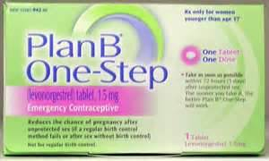
Type: Morning After Pill
How it works: Pill taken by the female after sex
Success rate: 89 percent effective when taken within 72 hours (three days) after unprotected sex. Levonogestrel pills may not work as well for women who have a body mass index (BMI) of more than 25.
Protection from STD’s: None
Benefits: Can help to reduce the risk of pregnancy in an emergency
Cost: From $30 to $65

Slide 33
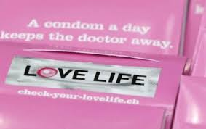
Condom Lineup Activity

Slide 34
Steps in CONDOM Use
1-Purchase and check date
2-Sexual Arousal
3-Erection
4-Carefully remove from package
5-Squeeze out air from tip
6-Roll condom on
7-Intercourse
8-Ejaculation
9-Hold rim and withdraw
10-Remove and discard
11-Loss of erection
12-Relaxation

Slide 35
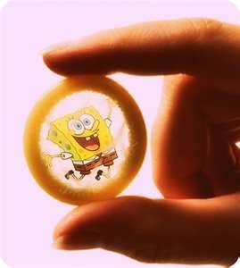
Free Condoms
http://city.milwaukee.gov/nocomdomnoway
Planned Parenthood
School nurse

Slide 36
ABC’s of Teen Pregnancy and STD Prevention
A= ABSTINENCE: only 100% effective way to prevent pregnancy and STI infection
B=BE FAITHFUL: You should wait as long as possible to start sexual activity because the earlier you start the more partners you will likely have. More partners means more likely to get an STI
C=USE A CONDOM: If you chose to have sex use a condom. “No” should not be an option, if your partner says that they are not looking out for your well being and this is not the kind of person you should be with

