Slide 1
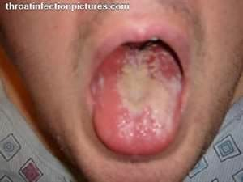
STD’s/STI’S

Slide 2
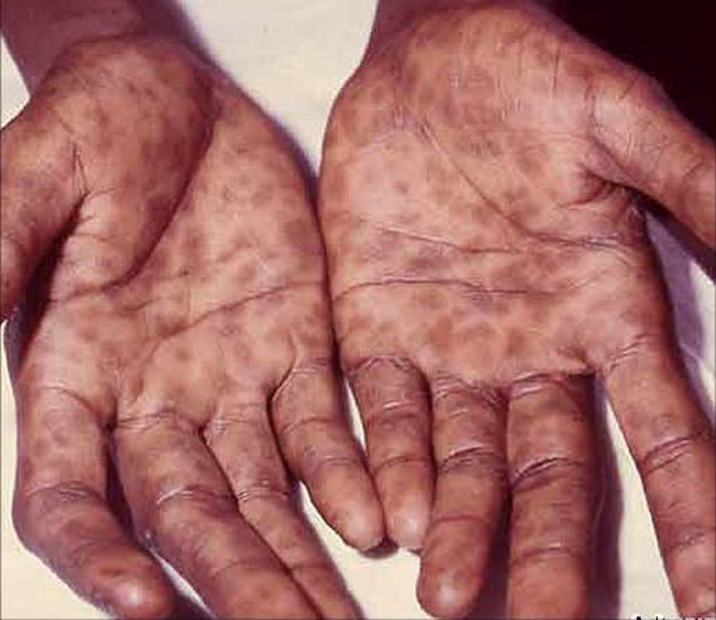
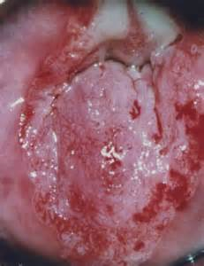
What is an STD?
STD=sexually transmitted disease
Also called an STI
Infection transmitted by sexual contact

Slide 3
Worried about STD’S? You shoud be……
Go undiagnosed
Having an STD increases your risk of other STD’s and HIV infection
Have periods of time where the person is symptomless and therefore you can unknowingly transmit them
Half of all STD’s occur in people under the age of 25
One in four cases happen in teenagers
The age group 15-24 has 5 times the normal rate of Chlamydia, 4 times the normal rate of gonorrhea, and 3 times the normal rate of syphilis
Being infected with one STD increases your risk of getting others

Slide 4
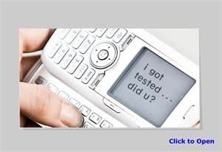
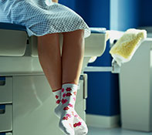
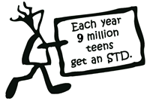
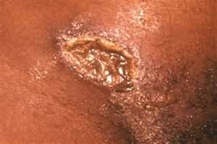
1 in 2
SEXUALLY ACTIVE
Young people
Will get
An STD
By the age of
25
MOST
Will not know it!!!!

Slide 5
STD Data in Milwaukee

Slide 6
What puts Teens at a higher risk??
More likely to have multiple, sequential, or concurrent sex partners, rather than single long term relationships
More likely to engage in unprotected sexual intercourse
They select partners that are at higher risk
“IF YOU DON’T TAKE RESPONSIBILITY FOR YOUR SEXUAL HEALTH, WHO WILL??

Slide 7
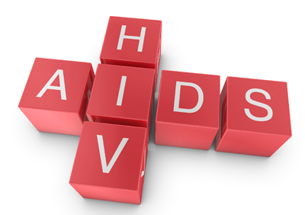
True or False? You can get an STD from…
Shaking hands
Sitting on a toilet
Getting coughed or sneezed on
Sharing utensils
Being bitten by an insect
False
False
False
False
False

Slide 8
You get an STD via Sexual Contact
Sexual contact means any intimate contact (not just intercourse) with another persons:
Lips
Mouth
Penis
Vagina
Anus

Slide 9
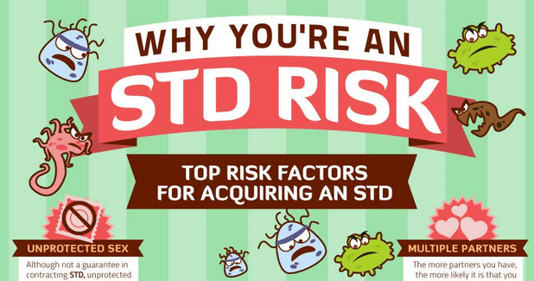
Risk Factors
Being a sexually active teen
Multiple partners
Not using latex condoms
Using drugs or alcohol

Slide 10
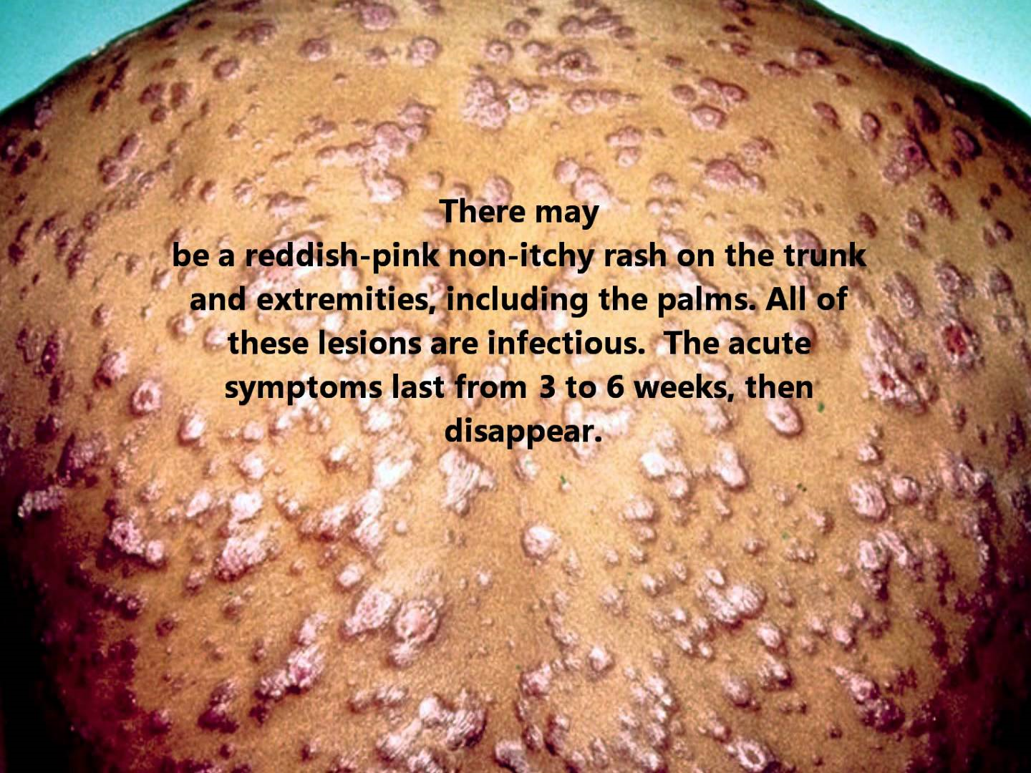
How will I know
Abdominal pain
Painful urination
Painful sex
Unusual discharge from the penis or vagina
Genital soreness, burning, itching
Unusual sores
or rashes

Slide 11
What should you do?
Seek medical attention from a Doctor
They will:
Take a sexual and health history
Do a physical exam
Take samples of urine, blood and or fluid from the sores
Interpret test results
Make a diagnosis

Slide 12
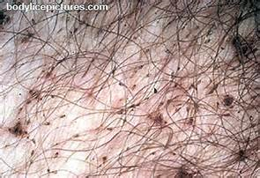
Categories of STD’s
Virus: No known cure, can only treat the symptoms.
Examples: Genital warts, genital herpes, hepatitis, HPV and HIV
Bacteria: Single celled microorganism. Cured by antibiotics.
Examples: Chlamydia, syphilis, gonorrhea, vaginitis.
Other Protozoan/parasites: Single celled organism. Cured by special medicated shampoos, and some oral medications.
Examples: Trichomoniasis, pubic lice, scabies.

Slide 13
Bacterial STDS
Can be cured with antibiotics
Can be acquired over and over again
Both partners must be treated at the same time to be effective

Slide 14
Bacterial STDS
Chlamydia
Gonorrhea
Syphilis

Slide 15
CHLAMYDIA
Over 1,000,000 new cases a year-1/2 of these are in 15-17 yr olds
If left untreated can lead to PID (Leading cause of PID)
Symptoms include:
yellow discharge from penis/vagina, painful urination, lower abdominal pain, swollen testicles, painful sex for women
75% of women have no symptoms

Slide 16
Gonorrhea
300,000 new cases a year, highest rate in 15-19 year old females
If left untreated is a leading cause of PID
Symptoms include:
Discharge, rectal bleeding and constipation, painful and frequent urination for males, spotting for females
Women often have no symptoms

Slide 17
PID-Pelvic Inflamatory Disease
Chronic painful infection of the female reproductive tract
Results from untreated chlamydia or gonorrhea
Treated with antibiotics
Affects over 1 million women each year

Slide 18
Syphilis
10,000 new cases a year
If left untreated can lead to paralysis, blindness, insanity or death
Causes a painless sore (chancre) to appear in 10-90 days
If left untreated causes flue like symptoms, rash on the palms of hands or soles of the feet
Very contagious
Lies dormant in the body causing organ damage, blindness, paralysis and death

Slide 19
Viral STDS
Cannot be cured; you’re infected for life
Common viral STDs:
HIV
Genital Herpes
Genital Warts (HPV)
Hepatitis B
May be controlled with anti-viral meds

Slide 20
Genital Herpes
1 in 5 sexually active people will get Herpes Simplex 2
1 in 4 women
1 in 8 men
It is painful and embarrassing but there are no long term heath risks

Slide 21
Symptoms
Itchy blisters on the genitals and surrounding area
Outbreaks usually become less frequent over time
Transmission can occur even between outbreaks
Many infected people never have an outbreak

Slide 22
Treatment
Meds can reduce symptoms during outbreaks
Anti-viral meds help reduce transmission
DO NOT HAVE SEX DURING OUTBREAKS!

Slide 23
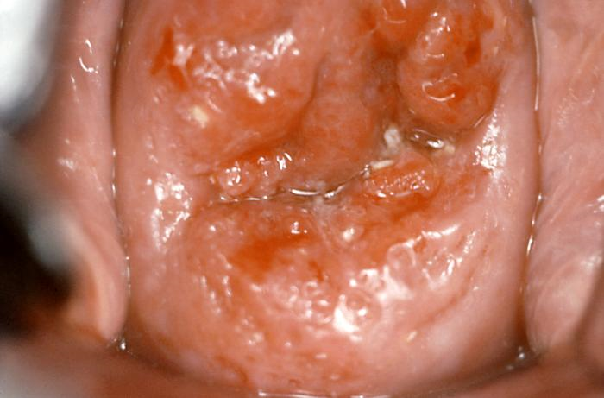
HPV = Human Papillomavirus
More than 100 viruses in the HPV family
40 of these are sexually transmitted
An estimated ½ of all sexually active people will be infected.

Slide 24
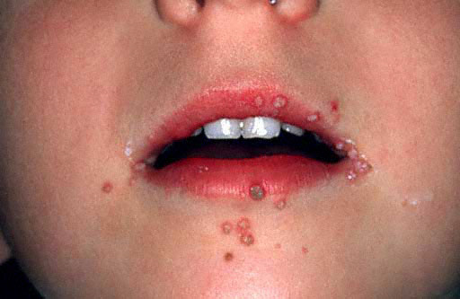
Symptoms
Warts on the penis, anus or groin, or in the throat
Warts may be flat, raised or cauliflower shaped
Warts may grow, remain the same or disappear
Most infected people have no symptoms

Slide 25
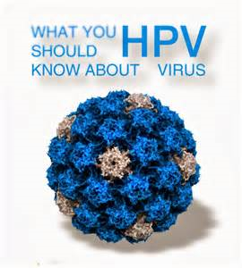
Risks
Cancer of the Cervix
Cancer of the Penis
Cancer of the Vagina
Cancer of the Anus

Slide 26
HPV Vaccine
Protects against 70% of the strains responsible for cervical cancer and some genital warts
Must be given before the infection occurs
Vaccine is approved for men and women

Slide 27
Treatment
Warts can be removed
Pre-cancerous tissue detected in Pap Smears can be removed
No medication exists for treatment

Slide 28
Hepatitis B
About 5,000 new cases a year
Virus infects the liver
Can cause liver cancer, failure and death
44 states require vaccine for public school attendance

Slide 29
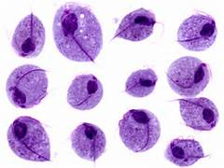
Other types of STD
Protozoa
Parasitic

Slide 30
Trichomoniasis
Caused by a protozoa
7.4 million cases a year (#1 STD)
The most common, curable STD among young women
Condoms prevent transmission

Slide 31
Symptoms
Appear in 1-4 weeks
Frothy, smelly vaginal discharge
Discharge from the penis
Genital itching
Painful intercourse
Painful urination
Men usually have no symptoms

Slide 32
Treatment
Anti-microbials
Repeat infections possible
Both partners must be treated at the same time

Slide 33
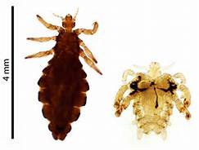
Pubic Lice
Tiny wingless parasitic insects, also called “Crabs”
Feed or burrow on blood
Lay their eggs on skin
New lice mature 2 weeks after hatching
Transmitted by close physical contact, sharing towels or clothing

Slide 34
Symptoms/Treatment
Redness
Swelling
Itching
Can quickly spread to anus, eyelashes and other areas of the body
Treated with specially medicated shampoos

Slide 35
HIV/AIDS Pre Test
1. Which statement best describes the relationship between HIV and AIDS?
a. HIV and AIDS are the same thing.
b. HIV can be cured but AIDS cannot be.
c. HIV is the virus that causes AIDS.
d. HIV has no relationship to AIDS.
2. Which of these statements about HIV infection is true?
a. HIV attacks cells of the immune system.
b. HIV can be detected with a blood test.
c. HIV can lead to AIDS if untreated.
d. All of the above

Slide 36
3. Who is most likely to get infected with HIV?
a. People who have unprotected sex.
b. Gay men.
c. People who donate blood.
d. People who get blood transfusions from donors.
4. What do people with HIV look like?
a. They are usually sick and frail.
b. They are usually well-groomed and strong.
c. They are usually like everyone else.
d. They are usually poor and shabby.
5. What is the relationship between sex and alcohol use?
a. Alcohol makes sex better.
b. Alcohol reduces a person’s interest in sex.
c. Alcohol kills germs so condoms aren’t necessary.
d. Alcohol reduces a person’s ability to make good decisions about sex.
j

Slide 37
6. How can the risk of an HIV infection be reduced?
Use a condom for sex every time.
Avoid injection drugs.
Abstain from sex and drugs.
All of the above.
7. Which of the following activities cannot transmit HIV?
everyday activities like talking, hugging, going to a movie
having unprotected sex with a regular partner
sharing needles to shoot drugs
All these activities are risky.
8. Which of these statements about HIV infection is true?
a. With medication, a person can live a fairly normal life.
b. Death occurs within months of HIV infection.
c. Medications can eliminate HIV from the body.
d. The HIV infection quickly spreads to the brain.

Slide 38
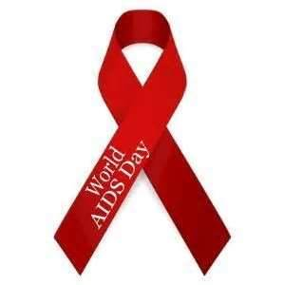
9. Which of these statements about women with HIV is true? a. They become sterile and cannot have children. b. They have difficulty becoming pregnant. c. They always pass HIV to their babies. d. They can have a baby that does not have an HIV infection. 10. What does the HIV test look for? a. the virus itself b. antibodies to the virus c. cells in the immune system d. signs that the immune system is very weak

Slide 39
HIV Statistics

Slide 40
HIV/AIDS STATS
In 2009 alone, there were an estimated 2,078 new cases of HIV infection in 13- to 19-year-olds and 6,314 new cases in 20- to 24-year-olds.
In 2007, HIV was the ninth leading cause of death for African-Americans of all ages and the third leading cause for African-American men and women between the ages of 35 and 44.
The Centers for Disease Control (CDC) report that 20 percent of reported new HIV infections in 2009 are in people under 25.
In 2009 in the US, 90 percent of the HIV infections in 13- to 19-year-olds were the result of sexual intercourse.
In the US in 2009 almost one-quarter of new HIV cases in 13- to 19-year-olds were female. In young people between the ages of 20 and 24, females made up 19 percent of all HIV cases.
—Sources: Centers for Disease Control and UNAIDS

Slide 41
In 2009 approximately 35 million people worldwide were living with HIV/AIDS. This is a decrease from 2002, when an estimated 42 million people worldwide were living with HIV/AIDS. More than 70 percent of these people live in Sub-Saharan Africa.
Worldwide, more than 80 percent of all adult HIV infections have resulted from heterosexual intercourse.
Approximately 50,000 new HIV infections occur in the United States each year; about 70 percent among men and 30 percent among women.
Through the end of 2008, approximately 617,000 people have died from AIDS in the US.
Approximately 1,000,000 people were living with HIV infection or AIDS in the US at the end of 2008. Of these an estimated 21 percent did not know they have it.

Slide 42
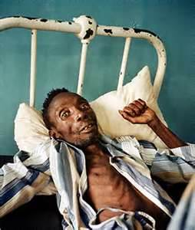
What is HIV?
Human Immunodeficiency Virus
Virus that causes AIDS
HIV damages the bodies immune system, thus causing
AIDS
People typically die from complications of a secondary infection or disease
How does HIV become AIDS
HIV destroys a certain type of blood
cell called the CD4+T cell

Slide 43
HIV/AIDS Facts
HIV can be transmitted through:
Blood
Semen or Pre-seminal fluid
Vaginal fluid
Breast Milk
HIV can enter through a vein, the lining of the anus or rectum, the lining of the vagina or cervix, the opening of the penis, the mouth or other mucus membrane.
It cannot enter through intact, healthy skin. It is not found in saliva, tears, sweat, urine , feces, vomit or nasal secretions unless blood is present.
Most common ways it is obtained
Unprotected Sex (anal, oral or vaginal)
Sharing needles
Mother to baby at birth or breast milk

Slide 44
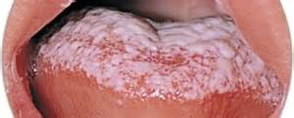
Symptoms
Flu like symptoms appear after a few weeks of infection
HIV and the immune system remain in a standoff battle for years
When immune system starts to lose after 5-8 years
weight loss, swollen glands, extreme fatigue and oral thrush happen
Death is possible if untreated

Slide 45
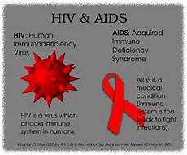
HIV TO AIDS
Scientists have estimated that about half the people infected with HIV develop AIDS within 10 years after becoming infected. This time varies greatly from person to person and can depend on many factors, including a person’s health care and lifestyle.

Slide 46
Special Cases
KISSING— Only one case of AIDS has ever been attributed to open-mouth kissing. However, because of the potential for contact with blood during open-mouth kissing, never practice this activity with someone who is infected.
SPITTING or BITING— Although saliva contains a very minor amount of HIV, it also contains a protein that works to destroy the virus. The amount of HIV in saliva is not high enough to make spitting or biting a common risk.
HEALTHCARE WORKERS— Investigations into more than 22,000 patients of 63 HIV-infected doctors and dentists have resulted in only one demonstrated case of HIV transmission.
SHARED UTENSILS— There is an extremely remote chance for HIV transmission, and only if blood is involved, such as from a cut in the mouth.
TEARS and SWEAT— These fluids do not contain enough HIV to cause infection.

Slide 47
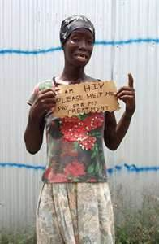
HIV Cannot Be Transmitted Through
Casual contact (social kissing, shaking hands, coughing, sneezing, swimming pools, bathrooms, eating utensils, drinking fountains)

Slide 48
How can I tell if I have HIV
Blood test
It takes 3 to 6 months after you are exposed to develop the detectable antibodies that tell if you have HIV
Dr. Office, STD clinics, Family planning services, HIV testing sites
WHO SHOULD BE TESTED
Men who have unprotected sex with other men
People who share needles
People with several sexual partners
People who already have another STI
Infants born to HIV positive mothers
People who are significantly exposed to another person’s blood
and they have open wounds, or exposure to open areas

Slide 49
WHERE CAN I GET MORE INFO?
Wisconsin AIDS line: 1-800-334-AIDS
Spanish speaking AIDS line: 1-800-344-7432
Red Cross
AIDS service organizations in Milwaukee
On the Web
Wisconsin AIDS/HIV Program
Centers for Disease Control
National Prevention Information Network

Slide 50
BLOOD LINES DVD

Slide 51
RED LIGHT – GREEN LIGHT ACTIVITY
RED LIGHT = HIGH RISK ACTIVITY
YELLOW LIGHT = MODERATE RISK ACTIVITY
GREEN LIGHT = LOW RISK ACTIVITY

Slide 52
High Risk Behaviors for getting HIV
Anal Intercourse without a condom
Sharing needles for injecting drugs, etc..
Vaginal intercourse without a condom
Anal intercourse with internal ejaculation with a condom
Vaginal intercourse with a condom and internal ejaculation
Sharing needles for tattooing, or piercing
Breast feeding by an infected mother
Unprotected oral sex
Cleaning blood spills with no barrier

Slide 53
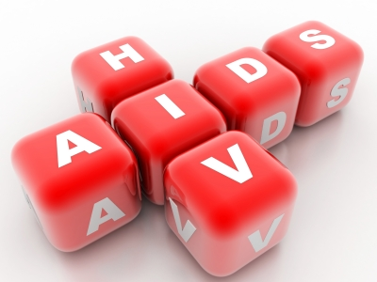
Low Risk Behaviors
Blood spills with barriers
Mutual masturbation
Deep wet kissing
Dry kissing
Hugging and massage
Self-masturbation
Donating blood
Mutually monogamous relationships with an uninfected partner
ABSTINENCE

